Slide 1

Challenges in Accelerator Physics
FAIRS Japan 2026: Future of Artificial Intelligence for Science in Japan
October 5th, 2026
Hirokazu Maesaka
RIKEN SPring-8 Center

Slide 2
Outline
Particle accelerators
Performance optimization
  Conventional optimization
  Bayesian optimization
  Physics-informed optimization
Optimizer based on reinforcement learning
Digital twin and surrogate model
Virtual diagnostics
Anomaly detection
Agentic AI workflow
Summary

Slide 3
Particle accelerators
RF acceleration
Bending/focusing magnets
Vacuum system
Beam diagnostics
Targets/Insertion devices
Synchrotron/
Storage ring/
Collider
Secondary beam/
Reaction products
Particle source
Linear accelerator
Beam transport
Secondary beam/
Reaction products
A particle accelerator is a large-scale, coupled, partially observable dynamical system.
Thousands of control parameters → thousands of observables → one beam
Performance optimization in both the design and commissioning stages is essential.
Stable and safe operation is important to maximize scientific outcomes from users.
A recent high-performance accelerator requires rigorous fine-tuning.

Slide 4


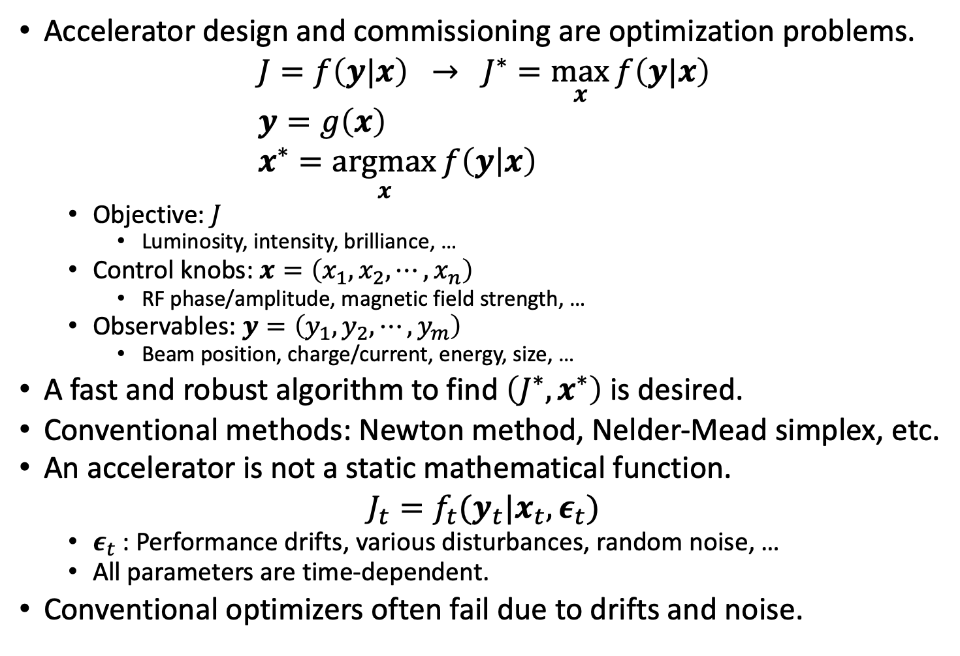



Performance optimization
Accelerator design and commissioning are optimization problems.
$J=f\left(y|x\right) → J^{∗}=\max_{x}{f\left(y|x\right)}$
$y=g\left(x\right)$
$x^{∗}=\underset{x}{argmax}{f\left(y | x\right)}$
  Objective: $J$
    Luminosity, intensity, brilliance, …
  Control knobs: $x=\left(x_{1},x_{2},⋯,x_{n}\right)$
    RF phase/amplitude, magnetic field strength, …
  Observables: $y=\left(y_{1},y_{2},⋯,y_{m}\right)$
    Beam position, charge/current, energy, size, …
A fast and robust algorithm to find $\left(J^{∗}, x^{∗}\right)$ is desired.
Conventional methods: Newton method, Nelder-Mead simplex, etc.
An accelerator is not a static mathematical function.
$J_{t}=f_{t}(y_{t}|x_{t}, ε_{t})$
  $ε_{t}$: Performance drifts, various disturbances, random noise, …
  All parameters are time-dependent.
Conventional optimizers often fail due to drifts and noise.
$$J, y$$
$$J \\ y$$
$$J^{∗}$$
$$x^{∗}$$
$$x$$

Slide 5
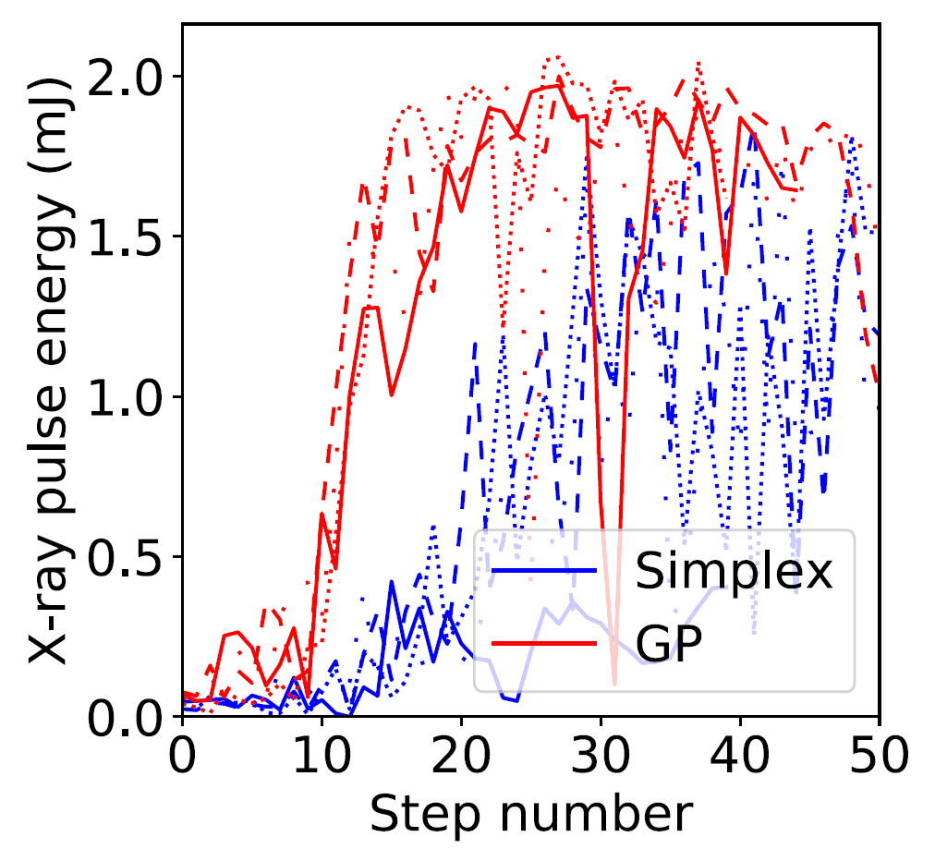
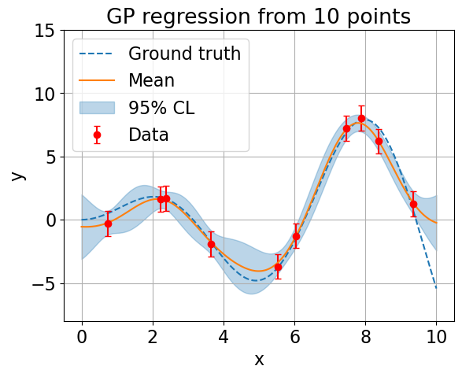
Bayesian optimizer
Example from LCLS
J. Duris et al.,. Phys. Rev. Lett. 124, 124801 (2020)
Optimization of XFEL pulse energy over 12 Quadrupole strengths in comparison with the Nelder-Mead simplex.
A Bayesian optimizer usually learns the function shape through observations and exploration.
Gaussian process optimizer is widely applied to various accelerators.
It is difficult to implement complex physical constraints in advance.

Slide 6
Physics-informed optimization
Bayesian optimization is data-efficient, but not necessarily physics-aware.
  It may explore physically implausible regions simply because they are statistically promising.
Physics-informed optimization uses physics knowledge to guide the search toward physically meaningful regions.
  It can make efficient decisions by combining data with physical insight.
Physics knowledge
  Equations
  Scaling laws
  Beam dynamics
  Known correlations
Machine knowledge
  Historical data
  Previous optimization results
  Machine state
  Operating instructions/codes
Operational knowledge
  Safe regions
  Forbidden regions
  Typical tuning procedures
  Operator experience

Slide 7
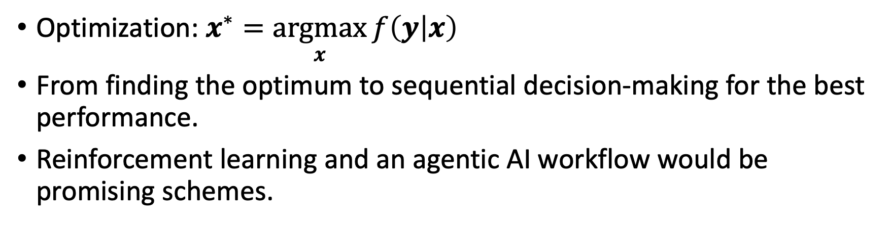
From finding the optimum to making decisions
Optimization: $x^{∗}=\underset{x}{argmax}{f\left(y | x\right)}$
From finding the optimum to sequential decision-making for the best performance.
Reinforcement learning and an agentic AI workflow would be promising schemes.
Observe state
Choose action
ML Optimizer
Accelerator
Reward

Slide 8
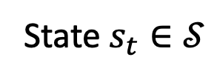

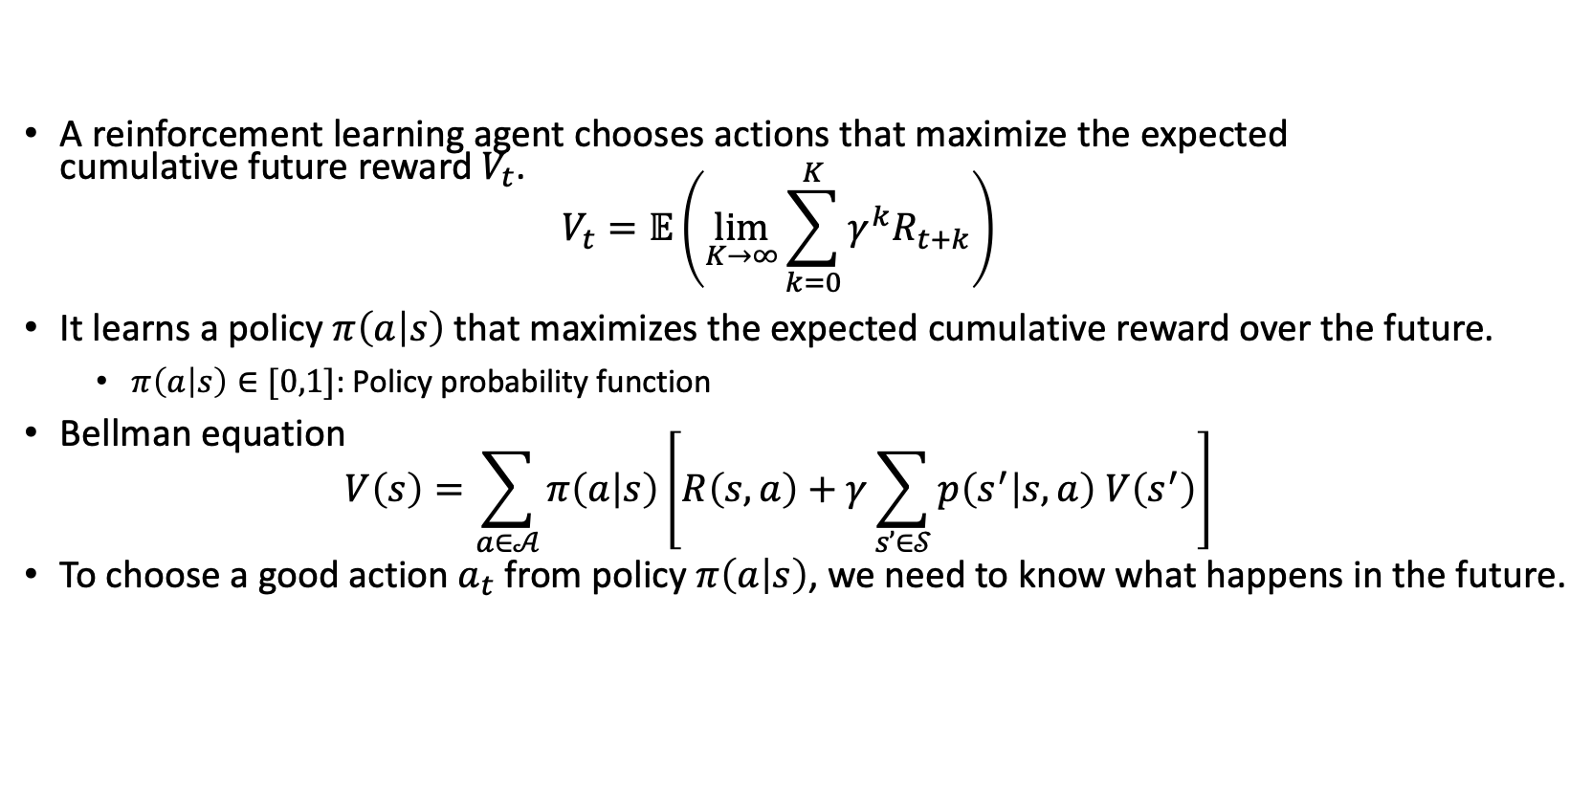
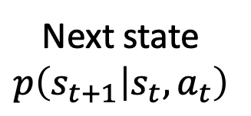
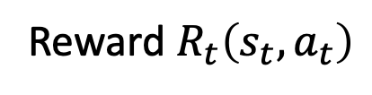
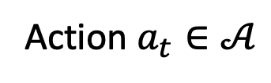
Reinforcement Learning: Optimize the future
State $s_{t}∈𝒮$
Action $a_{t}∈𝒜$
RL Agent
Accelerator
Reward $R_{t}\left(s_{t},a_{t}\right)$
Next state
$$p\left(s_{t+1} | s_{t},a_{t}\right)$$
A reinforcement learning agent chooses actions that maximize the expected
cumulative future reward $V_{t}$.
$V_{t}=𝔼\left(\lim_{K→∞}{\sum_{k=0}^{K}{γ^{k}R_{t+k}}}\right)$
It learns a policy $π\left(a | s\right)$ that maximizes the expected cumulative reward over the future.
  $π\left(a | s\right)∈[0,1]$: Policy probability function
Bellman equation
$V\left(s\right)=\sum_{a∈𝒜}{π\left(a | s\right)\left[R\left(s,a\right)+γ\sum_{s’∈𝒮}{p\left(s^{′} | s,a\right) V\left(s^{′}\right)}\right]}$
To choose a good action $a_{t}$ from policy $π\left(a | s\right)$, we need to know what happens in the future.
$γ$: discount factor

Slide 9
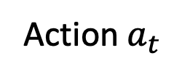
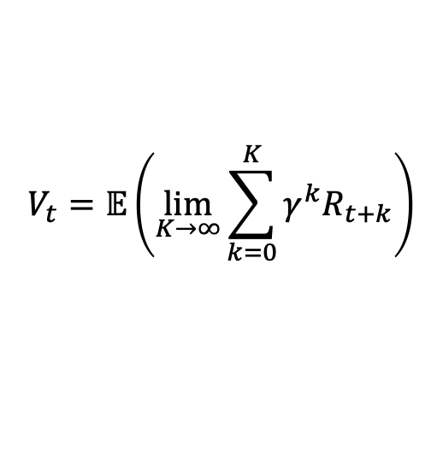
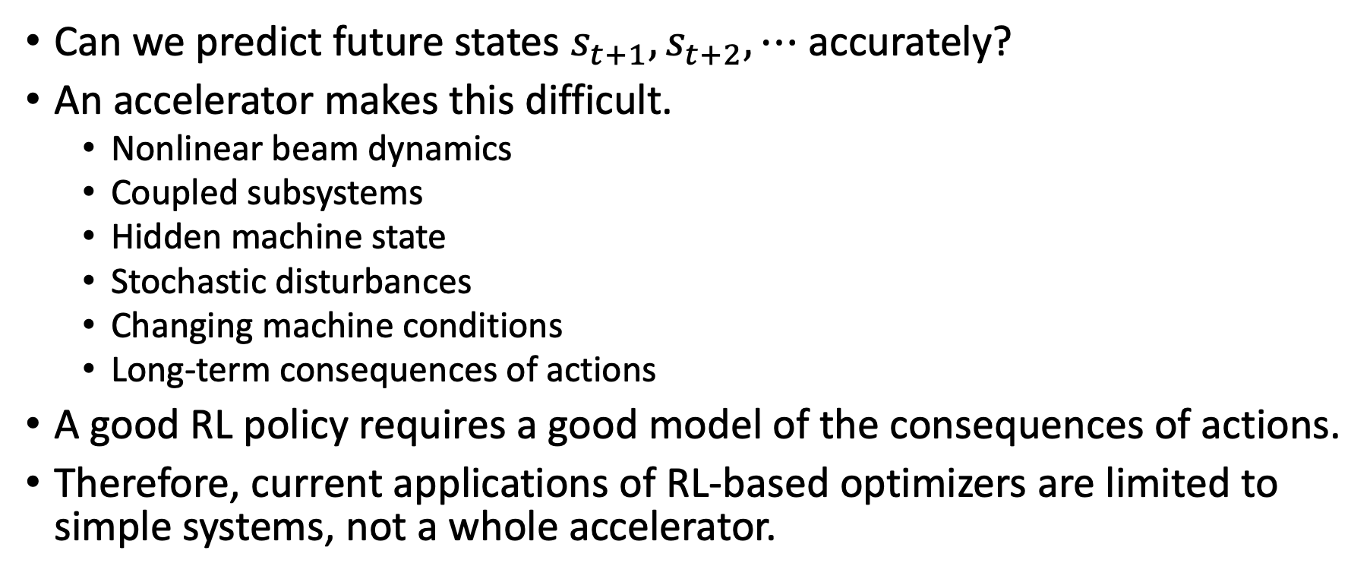
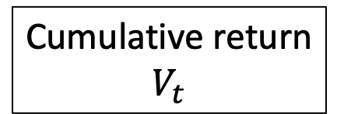
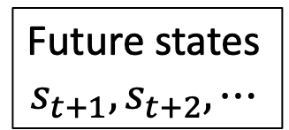
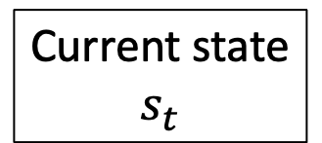
The hidden difficulty: predicting the future
Action $a_{t}$
Current state
$$s_{t}$$
Future states
$$s_{t+1}, s_{t+2}, ⋯$$
Cumulative return
$$V_{t}$$
Accelerator
$$V_{t}=𝔼\left(\lim_{K→∞}{\sum_{k=0}^{K}{γ^{k}R_{t+k}}}\right)$$
Can we predict future states $s_{t+1},s_{t+2},⋯$ accurately?
An accelerator makes this difficult.
  Nonlinear beam dynamics
  Coupled subsystems
  Hidden machine state
  Stochastic disturbances
  Changing machine conditions
  Long-term consequences of actions
A good RL policy requires a good model of the consequences of actions.
Therefore, current applications of RL-based optimizers are limited to simple systems, not a whole accelerator.

Slide 10
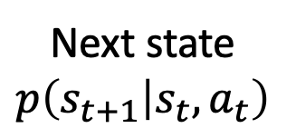
Let physics predict the future
What if we could simulate the accelerator accurately?
A digital twin allows the agent to learn the consequences of its actions without touching the real machine.
Building an accurate digital twin is a key challenge.
Actions
Digital Twin
Physics-based simulation
RL Agent
Future states and rewards
Action
Measurements
State/Reward
Accelerator
Next state
$$p\left(s_{t+1} | s_{t},a_{t}\right)$$

Slide 11
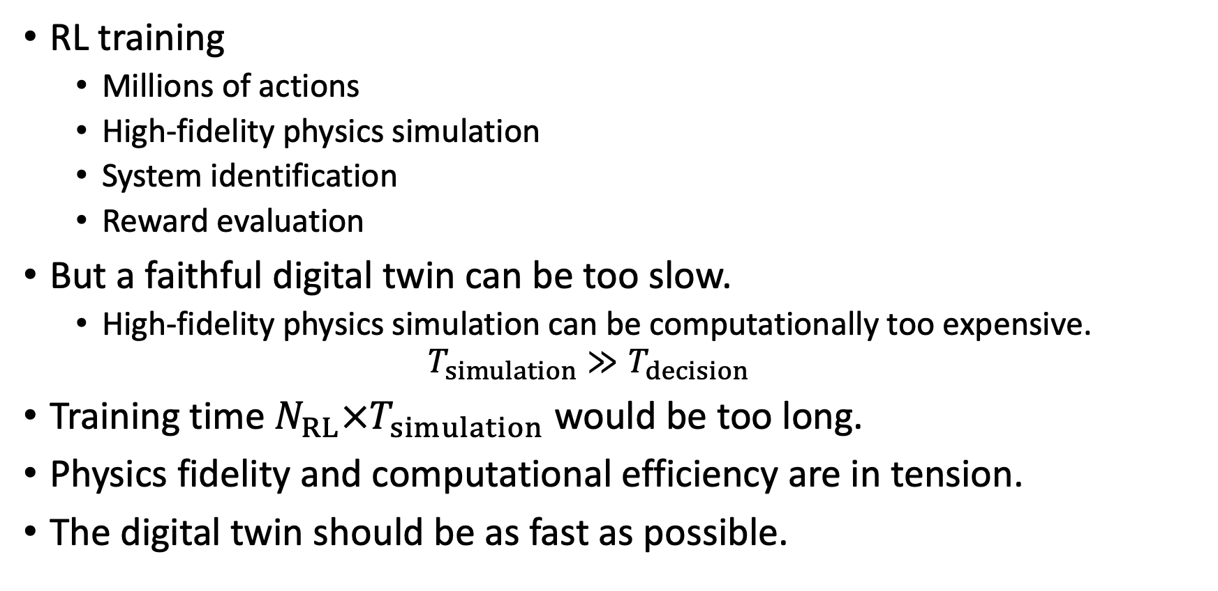
High-fidelity physics is expensive
Particle tracking
Electromagnetic simulation
Wakefield calculation
Space charge
Collective effects
Detailed beam dynamics
RL training
  Millions of actions
  High-fidelity physics simulation
  System identification
  Reward evaluation
But a faithful digital twin can be too slow.
  High-fidelity physics simulation can be computationally too expensive.
  $T_{simulation}≫T_{decision}$
Training time $N_{RL}×T_{simulation}$ would be too long.
Physics fidelity and computational efficiency are in tension.
The digital twin should be as fast as possible.

Slide 12
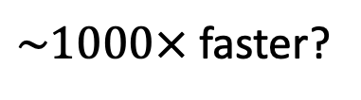
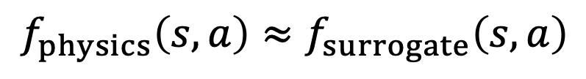
Surrogate models bridge physics and speed
Can we get a fast approximation of physics?
An ML-based surrogate model would be a solution.
Approximated
outputs
High-fidelity physics simulations
Training data
Surrogate
Model
RL Agent
$\sim 1000×$ faster?
Training
$$f_{physics}\left(s,a\right)≈f_{surrogate}\left(s,a\right)$$
Challenges
  ML-friendly simulation codes and data formats.
  A common framework for accelerator digital twins and surrogate models.
  Common data formats and surrogate-model frameworks with other physics domains?

Slide 13
Resulting architecture
State
State
Digital Twin
Simulations
Action
Action
Physics knowledge
RL Agent
Accelerator
Surrogate Models
Reward
Reward
Measurements
Physics-informed optimizer based on reinforcement learning.
  Pre-training of a digital twin with physics knowledge.
  Fine-tuning of the digital twin with real accelerator behaviors.
  Training of an RL agent with the digital twin and the real accelerator.
  Applying the RL agent to the real accelerator.

Slide 14
A digital twin needs to know the real machine state
A real accelerators often provides only limited and indirect measurements of the beam.
Beam profile
Beam position
Beam charge/current
Radiation spectrum
…
Emittance → luminosity/brilliance
Phase-space distributions
Sliced properties
…
Estimate
ML-based virtual diagnostics can infer the underlying beam state from these observations.
Limited measurements
Digital Twin
Estimated beam state
Virtual diagnostics
Simulations
Accelerator
RL Agent
Surrogate Models

Slide 15
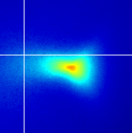
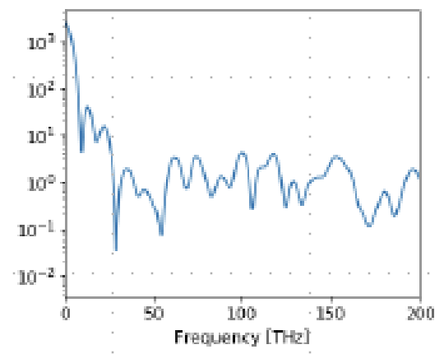
Two fundamentally different diagnostics
Beam diagnostics: accuracy vs. availability
Destructive diagnostics can provide rich information, but cannot be used continuously.
Non-destructive diagnostics can operate continuously and in real time, but often provide only indirect or incomplete information.
Destructive
  Screen/profile monitor
  Faraday cup
  Transverse RF deflector
  Transition radiation
Non-destructive
  Beam position monitor (BPM)
  Current transformer
  Beam loss monitor
  RF pickup
  Synchrotron radiation
Extracting more information from non-destructive diagnostics is also a key challenge.

Slide 16
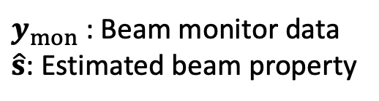

Virtual diagnostics
Virtual diagnostics infer what we cannot directly measure.
Physics
Equations
Simulations
Beam monitors
2D profile image
Position
Charge/current
Transverse RF deflector
Radiation spectrum
Estimated beam properties
Emittance
Bunch length
6D phase-space distribution
Sliced properties (size, intensity)
ML-based
Model
$$\overset{ˆ}{s}=g\left(y_{mon}\right)$$
$y_{mon}$: Beam monitor data
$\hat{s}$: Estimated beam property
Virtual diagnostics models are trained using physics simulation.

Slide 17
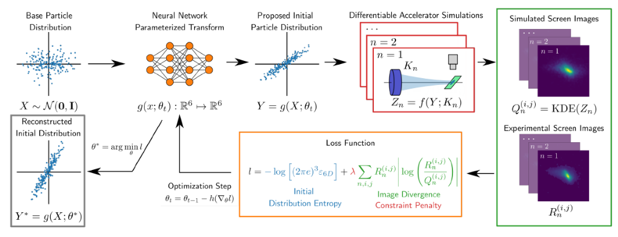
Generative Phase-Space Reconstruction
Ryan Rousell et al., Phys. Rev. Lett. 130, 145001 (2023).

Slide 18
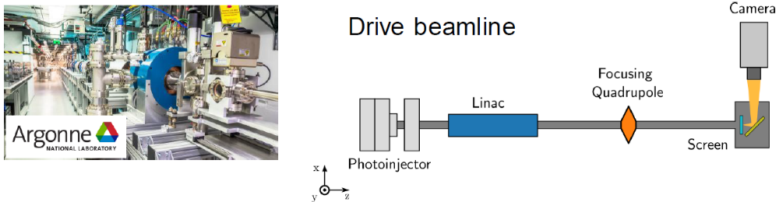
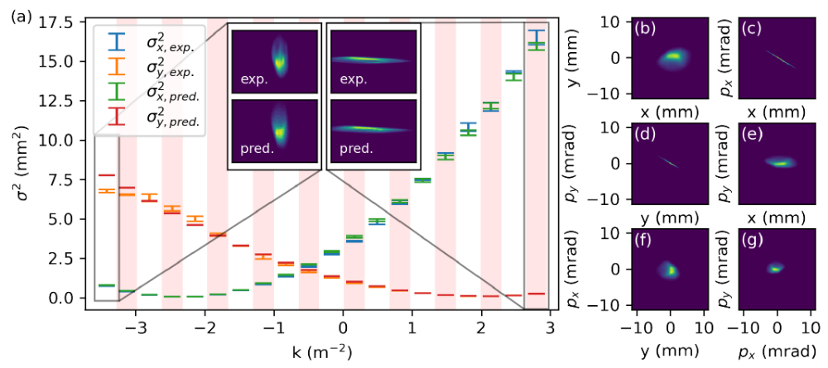
Experimental results from AWA
AWA: Argonne Wakefield Accelerator
Ryan Rousell et al., Phys. Rev. Lett. 130, 145001 (2023).
Reconstruction of 4D phase-space distribution

Slide 19
Another key issue: Stable operation
Early detection of anomalies enables preventive actions and more stable accelerator operation.
From rule-based to ML-based anomaly detection
  Instead of defining anomalies by fixed rules and thresholds, ML models learn the normal behavior of the accelerator and detect deviations from it.
  This can enable earlier detection of subtle anomalies before they become operational problems.
Conventional anomaly detection
ML-based anomaly detection
Alarm!!
Alarm!!
Threshold
An ML model detects deviation from the normal state
Time
Time

Slide 20
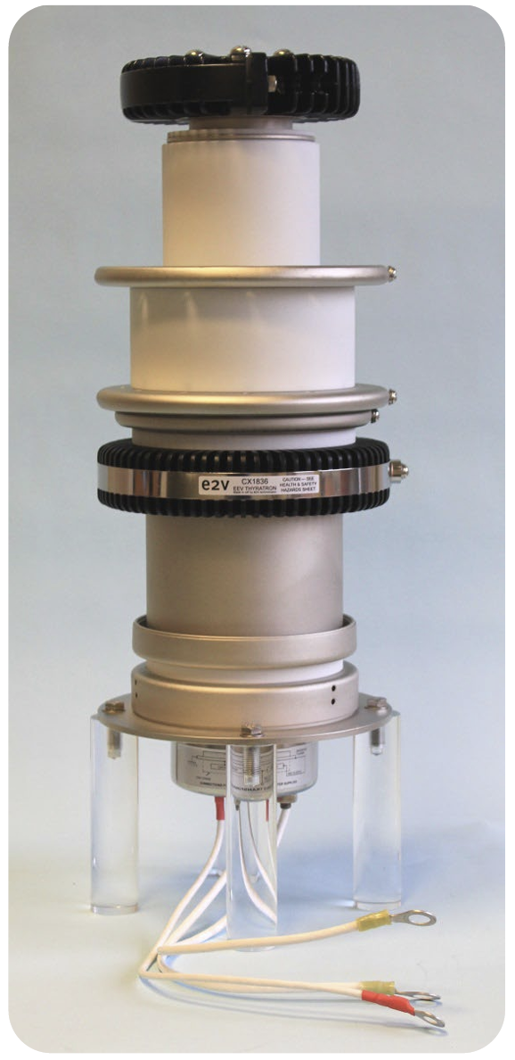
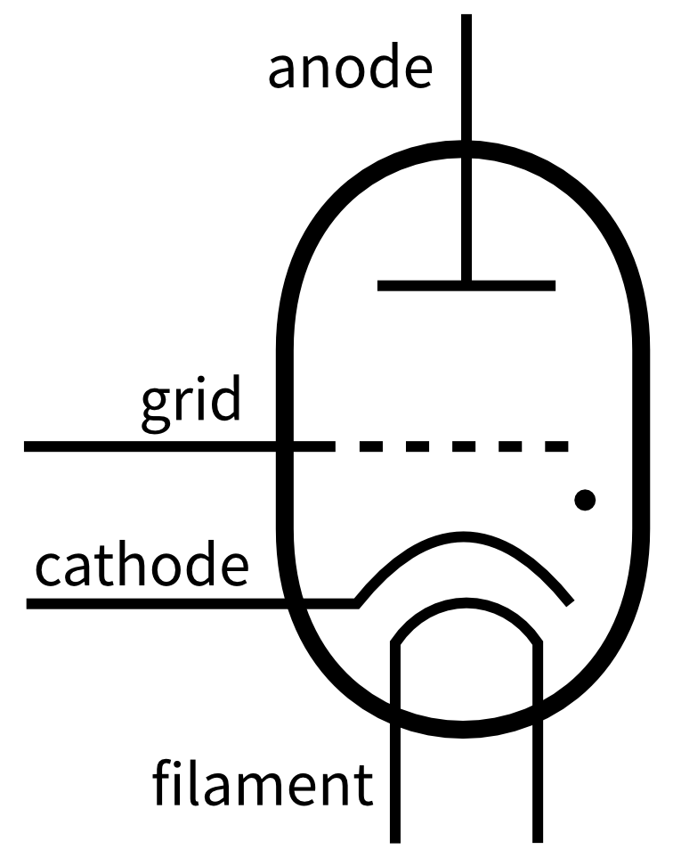
Example: thyratron discharge rate
A thyratron is a gas-fill tube used as a high-voltage and high-power switch.
The average lifetime of the thyratron is about 20,000 hours (a few years), which is relatively shorter than the other high-power devices.
The operation of SACLA is often suspended by the failure of a thyratron, so failure prognosis is important for the stable operation.
Major failure modes of the thyratron
  An increase in the self-discharge rate.
  A backward high-voltage pulse from the grid.
Teledyne e2v CX1836
https://www.teledyne-e2v.com/en-us/solutions/rf-power/rf-devices/thyratrons

Slide 21
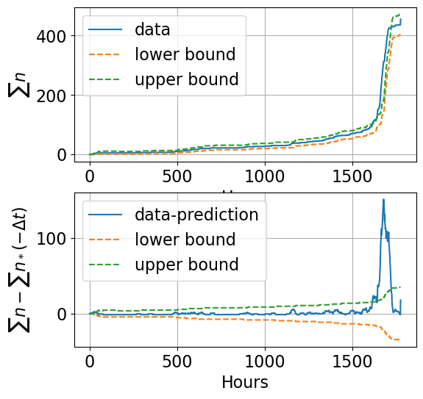
Anomaly detection of discharge rate
We assume the self-discharge rate follows a Poisson distribution.
The self-discharge rate of the normal state is learned during stable operation.
If the self-discharge rate exceeds a certain limit, an alarm signal is sent to the operator.
We can prepare the replacement work in progress of the actual failure.
Anomaly!!

Slide 22
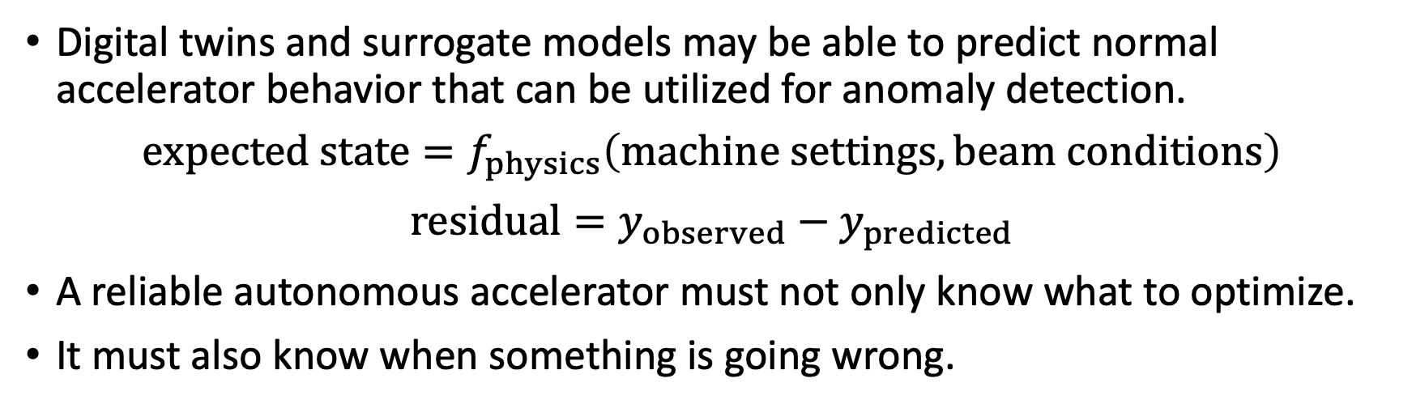
Physics-informed anomaly detection
$\text{Digital twins and surrogate models may be able to }$predict normal accelerator behavior that can be utilized for anomaly detection.
$$\text{expected state}=f_{physics}\left(\text{machine settings}, \text{beam conditions}\right)$$
$$\text{residual}=y_{observed}−y_{predicted}$$
A reliable autonomous accelerator must not only know what to optimize.
It must also know when something is going wrong.
Expectation
Digital Twin
Machine settings
Physics
Residual
Anomaly score
Accelerator
Data

Slide 23
Beyond the optimizer
Toward an intelligent accelerator agent.
Measurements/Virtual diagnostics
Optimize
Optimize
RL Agent
Accelerator
Digital Twin
Expectation
Status
Anomaly detection
Each technology solves one task.
But accelerator operation is not one task.
We need an agent that can orchestrate these capabilities.

Slide 24
From an optimizer to an agent
The agent does not replace the optimizer.
It decides when, why, and how to use optimizers and other ML tools.
Traditional optimizer
Action
Optimizer
Accelerator
Objective
Agentic AI
Optimizer
Agent
Plan
Reason
Act
Observe
Accelerator
Diagnostics
High-level goal
Anomaly detector
Digital Twin
Sub-agents

Slide 25
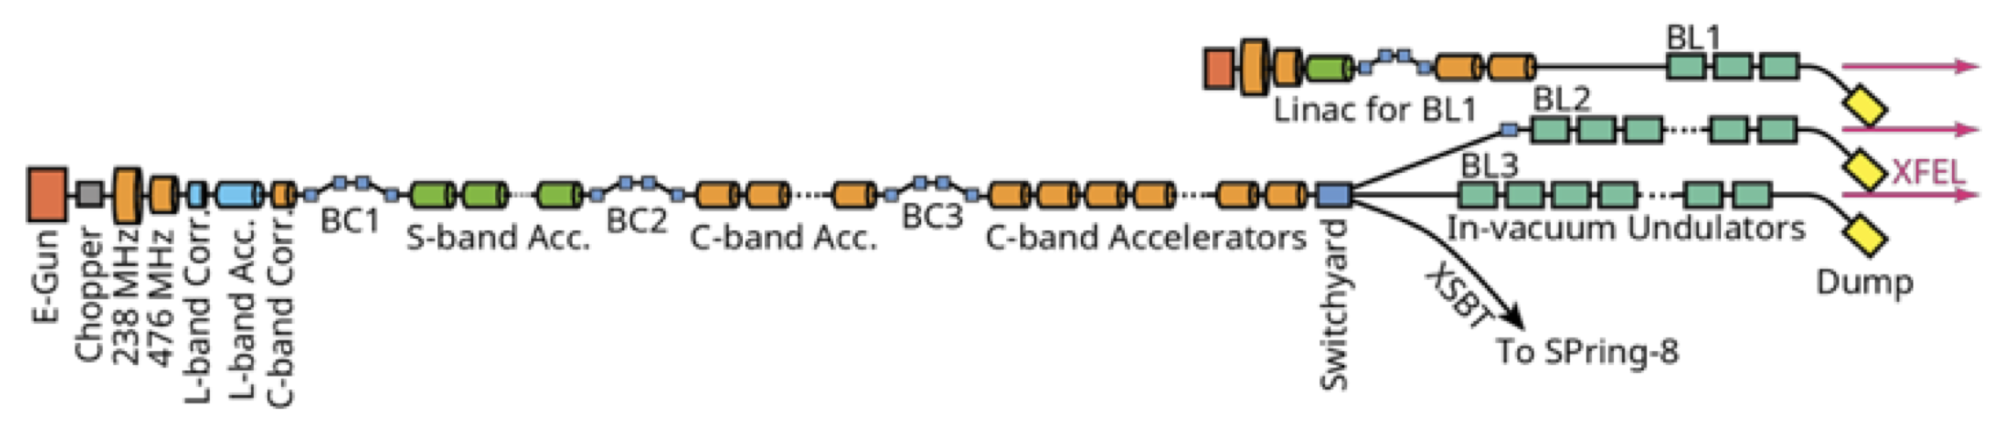

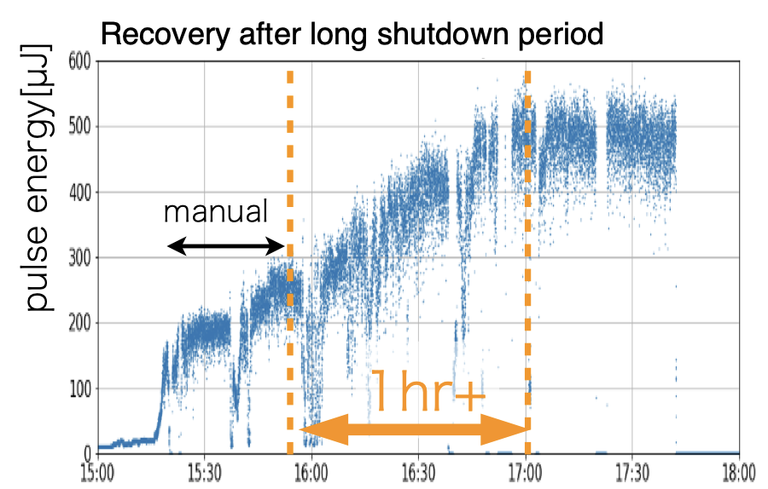

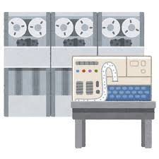
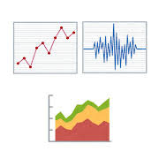
Traditional ML-based optimization
Results
Actual machine
Change
parameters
Configuration
Manual trial
and error
Optimizer
Gaussian Process
Reinforcement Learning
Operator/
Researcher
Score
Configuration
Simulators
Analysis

Slide 26


Agentic AI-based operation
Knowledge Base
Source codes
Manuals
Logbooks
Response
Tuning
Actual machine
Automatic iterative trial and error
Requests
Natural language
Operator
Configuration
Agent
LLM
Claude
GPT
Open-weight models
Results
Digital Twin
Simulators
Surrogate models

Slide 27
Digital Twin as a safety sandbox
The digital twin is not only a training environment.
It is a safety sandbox for the agent.
Never let the agent explore blindly on the real machine.
Autonomous does not mean human-out-of-the-loop.
Agents should know when to ask a human.
Proposed
action
Human approval
if high risk
Automatic execution
if low risk
Agent
Predicted performance
Predicted risk
Digital Twin
Response
Accelerator

Slide 28
Foundation model for accelerators
What capabilities are required of the foundation model for an accelerator agent?
A general-purpose foundation model itself is not the accelerator agent.
Fine-tuning may be needed for AI agents for physics/science.
  Genesis Open Models: https://genesisopenmodels.anl.gov
Physics knowledge
  Accelerator physics
  Beam dynamics
  RF/magnet/vacuum/…
  Experimental knowledge
Reasoning/planning
  Multi-step planning
  Causal reasoning
  Uncertainty awareness
  Hypothesis generation
Tool calling/APIs
  Optimizer
  Diagnostics
  Control system
  Simulation
  Database/Knowledge base
Foundation model
Physics
knowledge
Reasoning
Planning
Tool calling
APIs
Accelerator agent

Slide 29
Interface itself is a research challenge
How should a physical system expose itself to an AI agent?
The interface between AI and the physical world is a domain challenge.
Ongoing project: Osprey framework
  https://github.com/als-apg/osprey
  A production-ready architecture for deploying agentic AI in large-scale, safety-critical control system environments
Natural
language
Agent protocol
Optimizer
Diagnostics
Control
Simulation
Knowledge base
Accelerator
Human
Agent
APIs
Figures
Approval/permission
Digital Twin
State representation
Action representation
Tool interfaces
Safety constraints
Uncertainty

Slide 30
From optimization to intelligent operation
From physics-informed optimization to intelligent accelerator operation.
Iterative trial and error with a real accelerator and a digital twin.
Can we build an AI scientist for accelerator physics?
Can it find a new operating point with higher performance than ever achieved?
Human Supervision
AI Scientist
Actual behavior
AI Agent
Plan
Reason
Learn
Decide
Tools
ML-based optimizer
Virtual diagnostics
Anomaly detector
Knowledge base
Accelerator
High-level goal
Digital Twin
Simulated response

Slide 31
Summary
Accelerator optimization is becoming increasingly intelligent.
  From numerical optimization → Bayesian optimization → Physics-informed optimization (RL, etc.)
Accelerator operation is a sequential decision-making problem.
  Reinforcement learning can learn what to do next by considering future consequences.
Digital Twins and surrogate models enable prediction and safe exploration.
  They can predict the consequences of actions without blindly experimenting on the real machine.
The machine state is only partially observable.
  Virtual diagnostics can infer rich beam information from limited measurement data.
Stable operation requires early detection of abnormal behavior.
  Anomaly detection should identify subtle precursors before they become critical problems.
The next challenge is to orchestrate these capabilities with an AI agent.
  Agentic AI can plan, reason, use specialized tools, and re-plan toward a high-level scientific goal.
Human expertise and AI must work together.
  Safe autonomous operation requires appropriate human oversight, interfaces, and trust.
Toward intelligent accelerator operation, we are aiming to build an AI scientist for accelerator physics.

