Slide 1
Taste of Machine Learning Applications at SLAC
Dec 3, 2024
D. Ratner
SLAC National Accelerator Laboratory

Slide 2
Outline
Surrogate models
Optimization
Anomaly detection
Reconstruction/Inverse problems
LLMs

Slide 3
Outline
Surrogate models
Optimization
Anomaly detection
Reconstruction/Inverse problems
LLMs

Slide 4
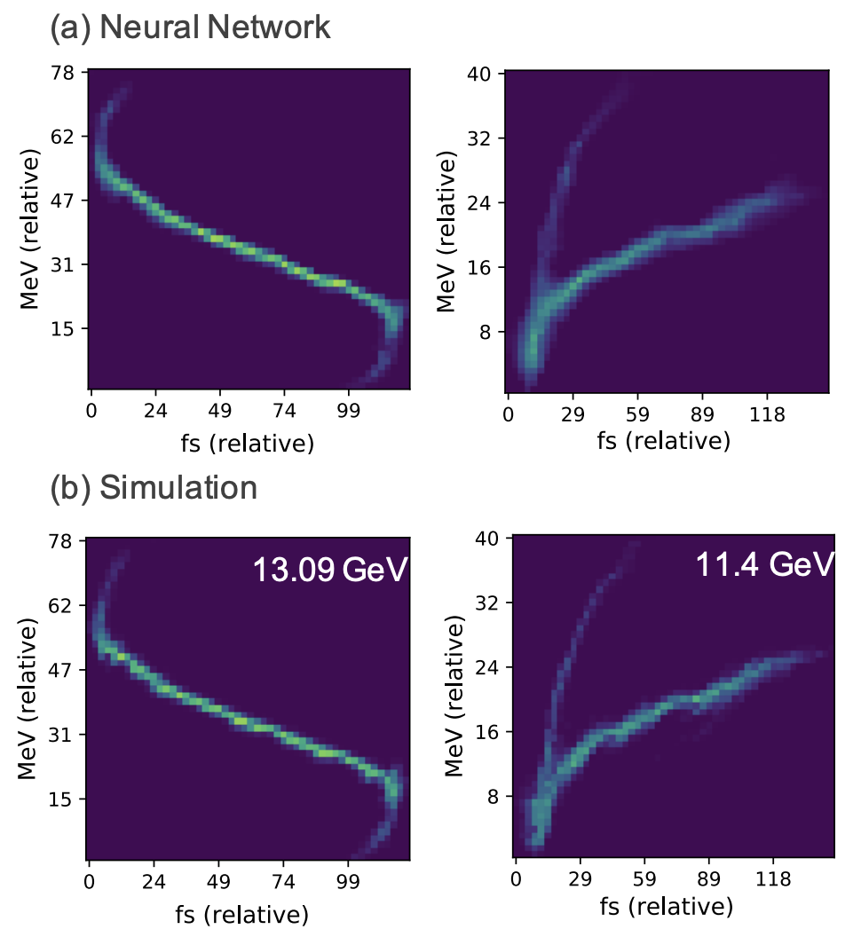
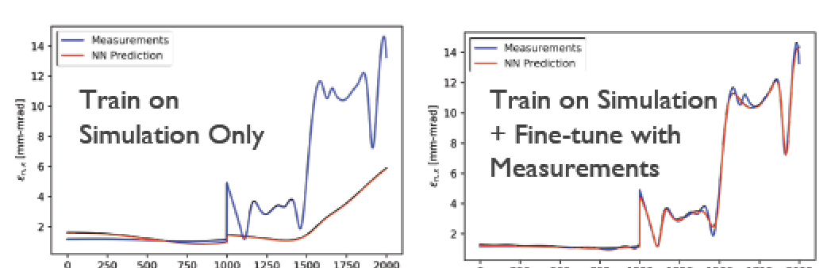
Surrogate Models: Motivation
Surrogate models: AI approximations of physics simulations
Motivation:
Reduce computational cost: AI models can many orders of magnitude faster!
  Note that training is expensive! ➔ requires running physics simulator and than training of surrogate
  Need frequent use of surrogate to justify
  (“amortization”)
Can be updated directly on experimental data (“Digital twins”)
  Train on simulations + experiments
  ➔ More accurate than physics sim!
Provide automatic derivatives
A. Edelen et al, ml4physics, NeurIPS, 2020
A. Edelen
Notes:
Genesis simulations provide users very accurate prediction of X-ray pulses for preparing for shifts and testing analysis methods. However, each simulation takes ~1000s of CPU-seconds. For users who require large numbers of examples, e.g.crystallography or statistical methods like ghost imaging, Genesis is too slow.
Generative adversarial networks (GANs) use two networks: the “discriminator” tries to identify if an example is real (i.e. Genesis), or fake (i.e. the “generator”). The generator tries to fool the discriminator. As the two networks fight, the generator makes more and more realistic examples. Images at right show a generated fake XTCAV image (upper right) and the associated X-ray profile (lower right, green). The blue curve is what the old XTCAV algorithm would have estimated from the fake example, showing that the generated example is reasonable.

Slide 5
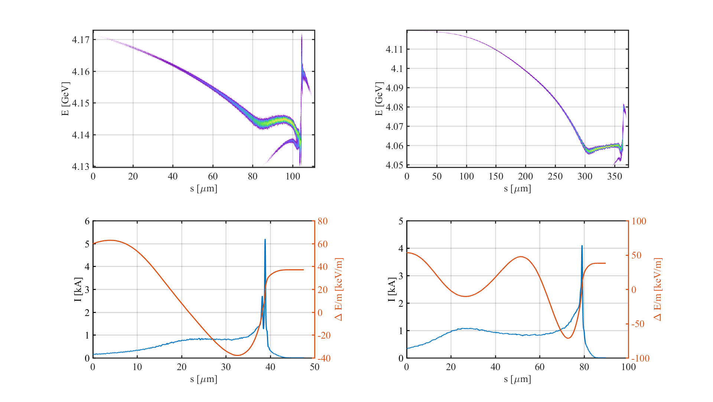
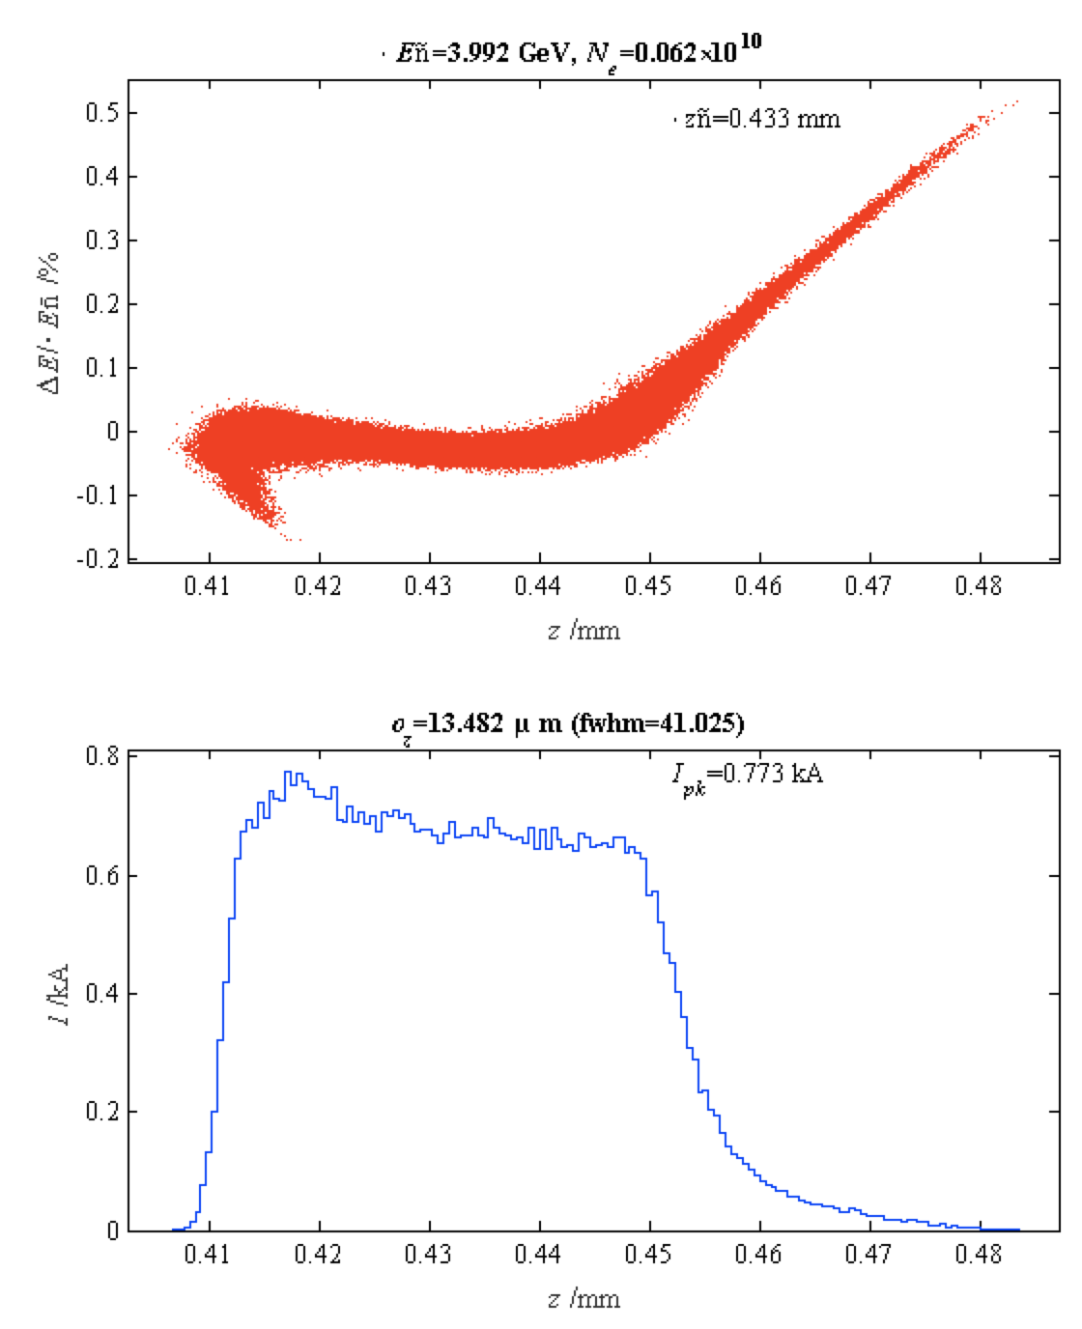
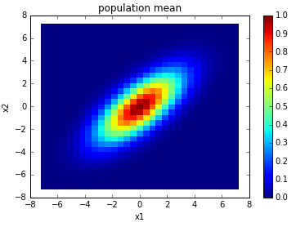
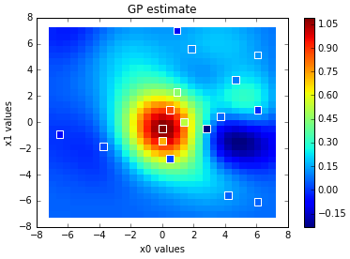
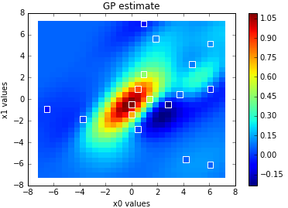
Surrogate Models: Applications
Applications for accelerators:
Designing new machines: surrogate executes faster than physics sim
“One-to-one” physics simulations take ~100k CPU hours
➔ Surrogate model <10⁻⁷ GPU hours
LCLS-II simulations, Y. Ding, J. Qiang
Live tuning of machines: surrogate trained during optimization
ρ = 0
ρ = 0.7
J. Duris, PRL, 2020
AI-based analysis: e.g. physics-informed NN to reconstruct physical observables/parameters

Slide 6
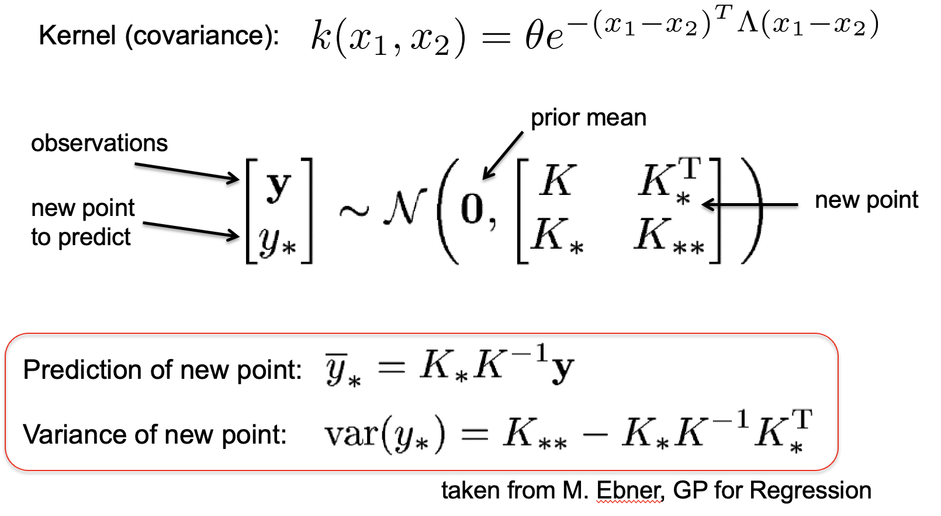
Surrogate Models: Gaussian processes
AI Method: Gaussian processes
Instance-based learning (e.g. support vector machines, k-nearest neighbor)
Effective with a small number of samples
Provides estimate and uncertainties
J. Duris, PRL, 2020

Slide 7
Outline
Surrogate models
Optimization
Anomaly detection
Reconstruction/Inverse problems
Large language models

Slide 8
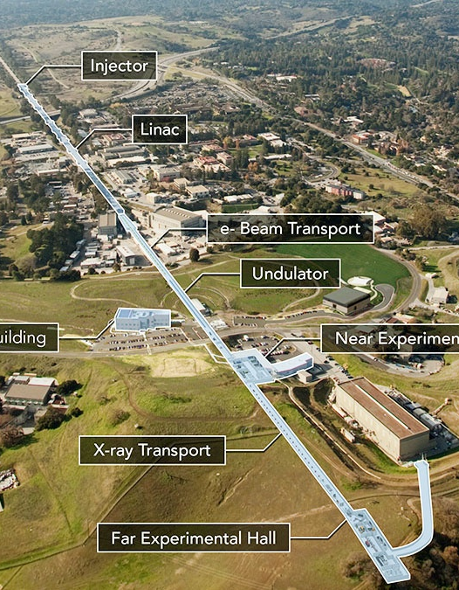
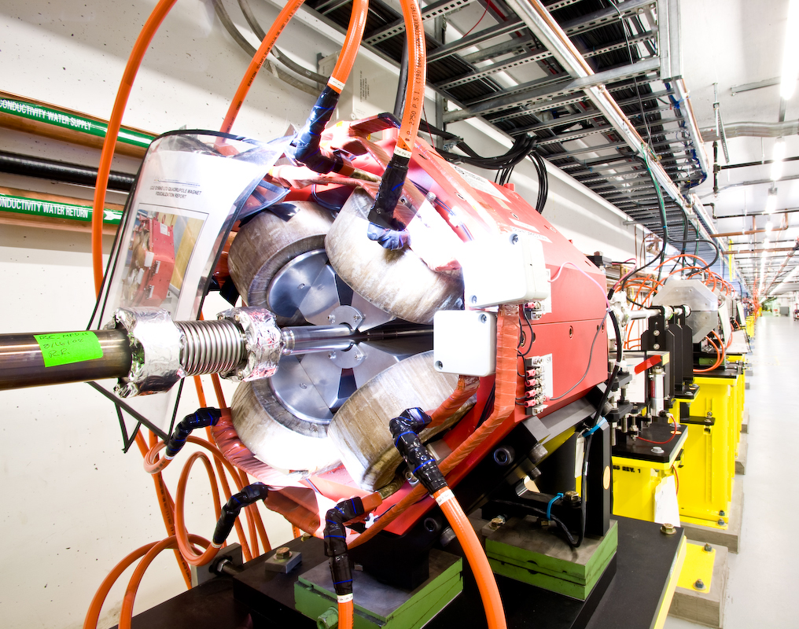
Optimization: Facility operation use case
Challenge: How to optimize a scientific facility? Many tuning knobs, acquisition is expensive ($50k/hour, ~$25M/year!), many operators/physicists to train
SoTA Problems: Manual tuning ➔ slow, depends on operator experience
Numerical optimizers ➔ ignores domain knowledge, inefficient
AI solution:
Model-based optimization leverages physics knowledge and past experience for efficient global optimization
Methods: Bayesian optimization (BO), reinforcement learning (RL)
Quadrupole magnets
Status:
BO in regular use for accelerators worldwide (10-100x speedup)
Active research in RL, NN priors, algorithmic execution (BAX), …

Slide 9
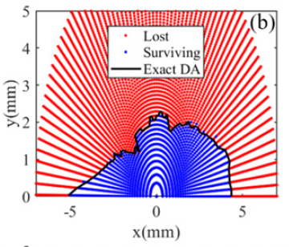
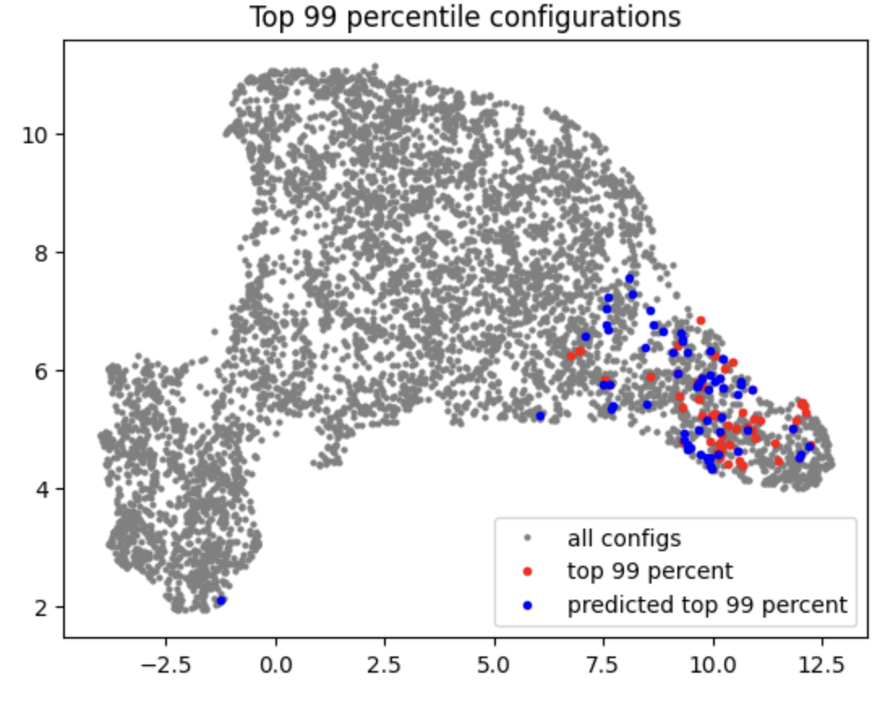
Optimization: Facility design use case
Challenge: How to design a new facility? High-dimensional search (e.g. dozens of sextupoles for modern rings), expensive simulations (e.g. tracking ~10⁶ turns)
SoTA Problems: Genetic algorithms are sample inefficient ➔ limited to low-dimensions, short tracking
AI solution:
Neural network surrogates approximate expensive simulations
Optimal design methods to maximize efficiency (e.g. Bayesian algorithmic execution)
Image courtesy J. Wan, Y. Jiao
Status:
Factor of ~100x speed-up from NN-based search
Employed for ALS-U, SSRL-X, FCC, and other designs

Slide 10
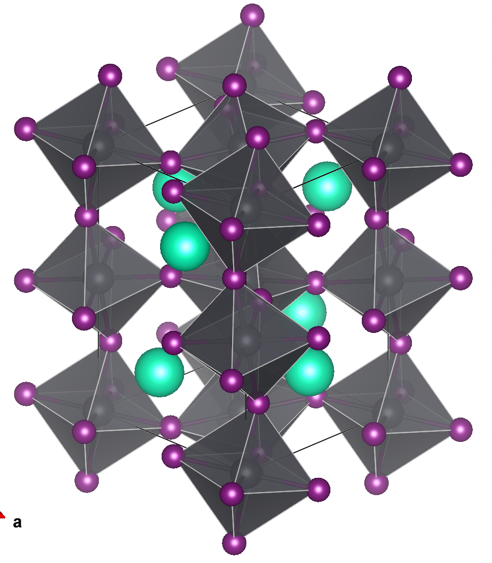
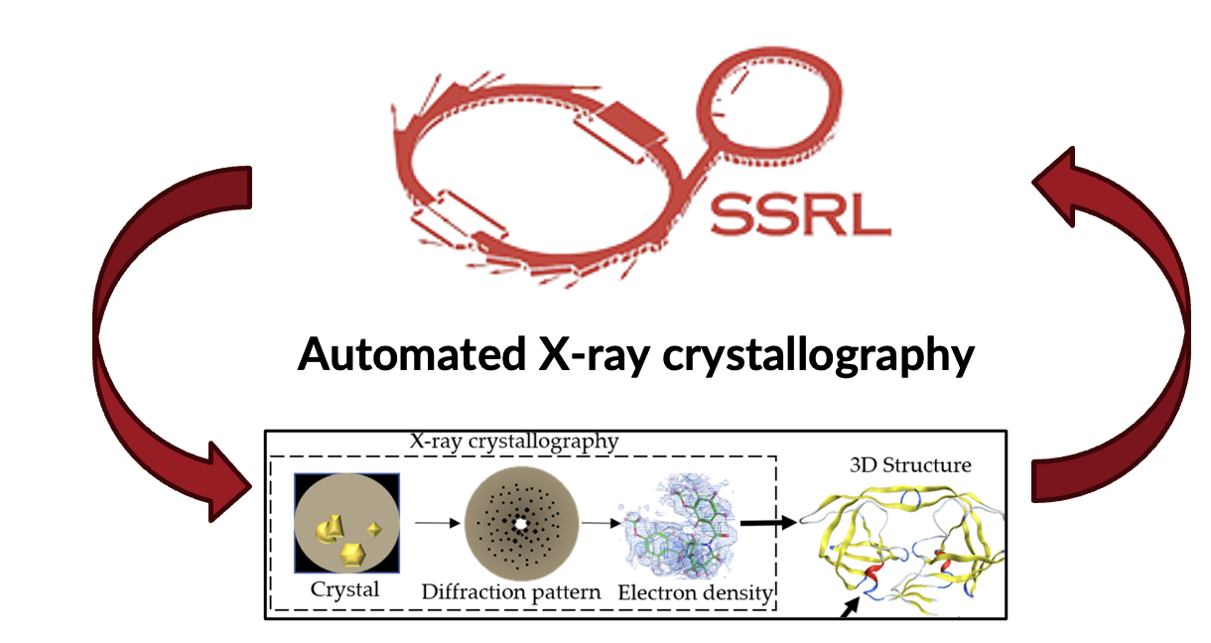
Optimization: Compound discovery
Challenge: How to discover a novel material? Design space is enormous (trillions of synthesizable drugs), and each measurement/calculation is costly.
SoTA Problems: Expert-guided search (e.g. hand-design of drugs by chemists). Efficiency directly corresponds to quality of final compounds.
AI solution:
Neural network surrogates predict properties
Optimal design methods to maximize efficiency (e.g. Bayesian algorithmic execution)
S. Gasiorowski, M. Han, Y. Lin
Status:
AlphaFold is now a core part of drug design
Experimental design for compound discovery still in early stages
S. Gasiorowski, D. Mendez, A. Cohen

Slide 11
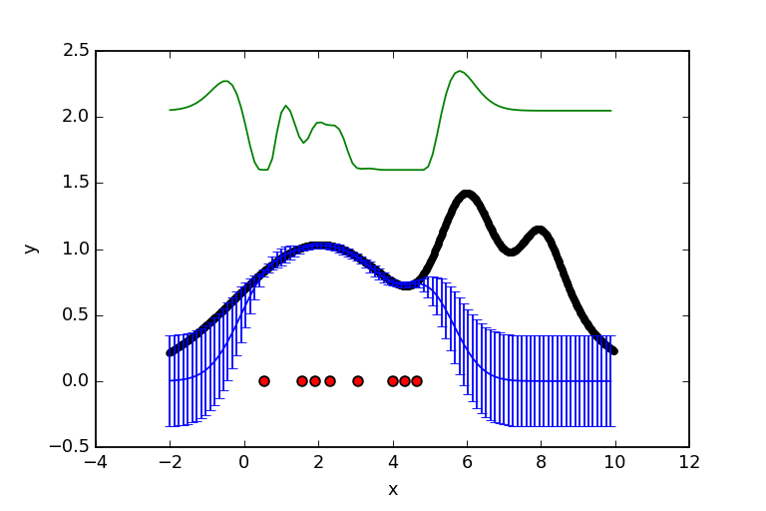
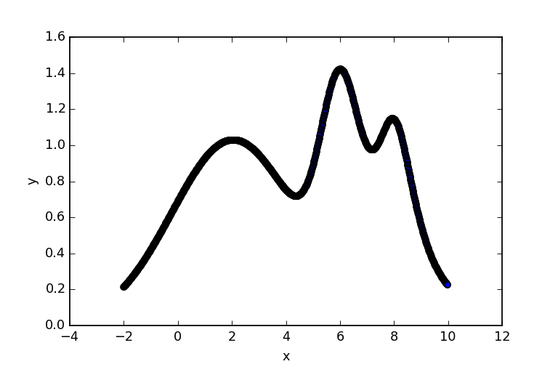
Optimization: Bayesian optimization
Model-based optimization
Advantage 1: Balance “exploitation vs. exploration”
➔ Find global maximum
Bayesian optimizer
Acquisition point
Gradient optimizer
Acquisition
function
Ground truth
Posterior
Mitch McIntire

Slide 12
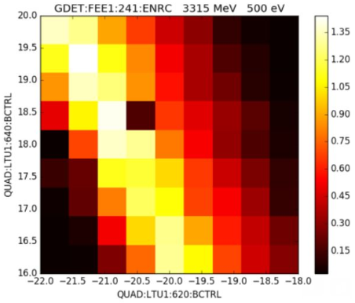
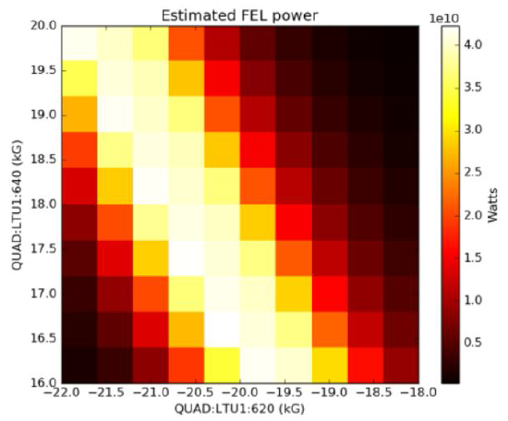
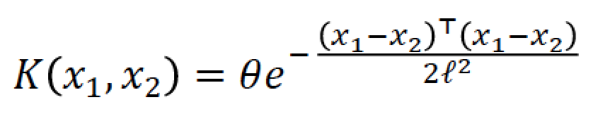
Optimization: Bayesian optimization
Model-based optimization
Advantage 2: Existence of model enables use of physics, archived data
Measured
Modeled
e.g. learning correlations in data improves modeling
Quad 2
Quad 1
Quad 1
Model,
no correlation
Model,
w/ correlation
Groundtruth
ρ = 0
ρ = 0.7
Bayesian Optimization of an FEL, Duris et al., PRL, 2020

Slide 13
Outline
Surrogate models
Optimization
Anomaly detection
Reconstruction/Inverse problems
Large language models

Slide 14
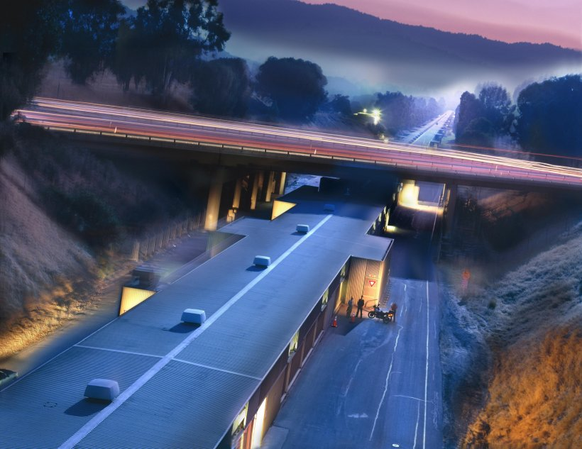
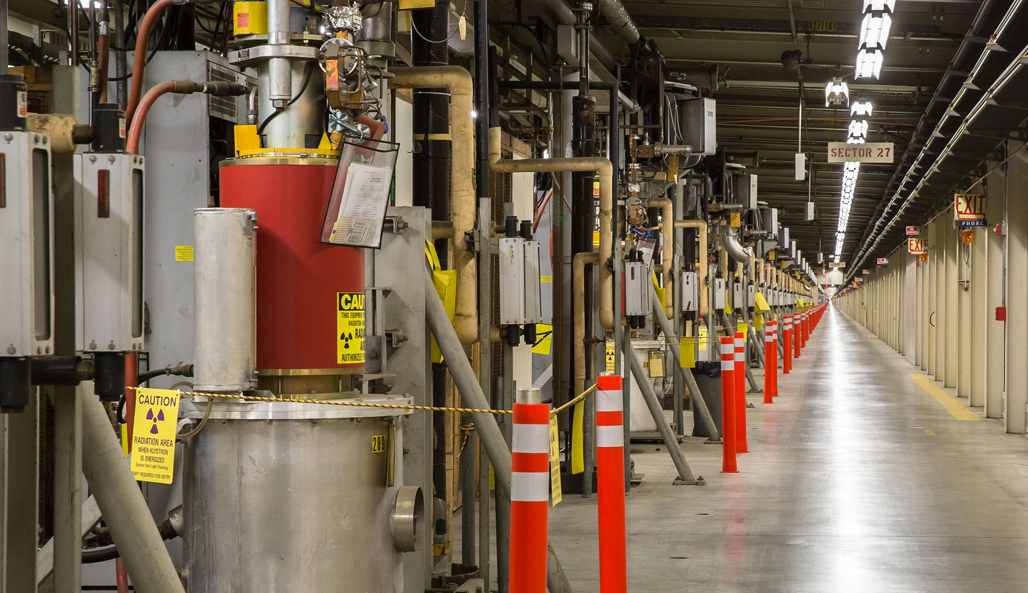
Anomaly detection: Facility prognostics use case
Challenge:
Modern facilities have thousands of sub-systems
➔ frequent failures
➔ downtime, poor performance
SoTA Problems:
Millions of diagnostics ➔ manual search infeasible
Simple thresholds are common ➔ poor precision and/or recall
SLAC Linear Accelerator and 280 Overpass
SLAC RF Stations
Recall = TP/(TP+FN) Precision = TP/(TP+FP)
TP = true positive, FP = false positive, FN = false negative

Slide 15
Anomaly detection: Facility prognostics use case
Challenge:
Modern facilities have thousands of sub-systems
➔ frequent failures
➔ downtime, poor performance
AI solution:
Neural networks learn normal distribution and identify outliers as anomalous
Unsupervised training ➔ can train on years of 1Hz archived data
Inference is cheap ➔ can run continuously
SLAC Linear Accelerator and 280 Overpass
SLAC RF Stations

Slide 16
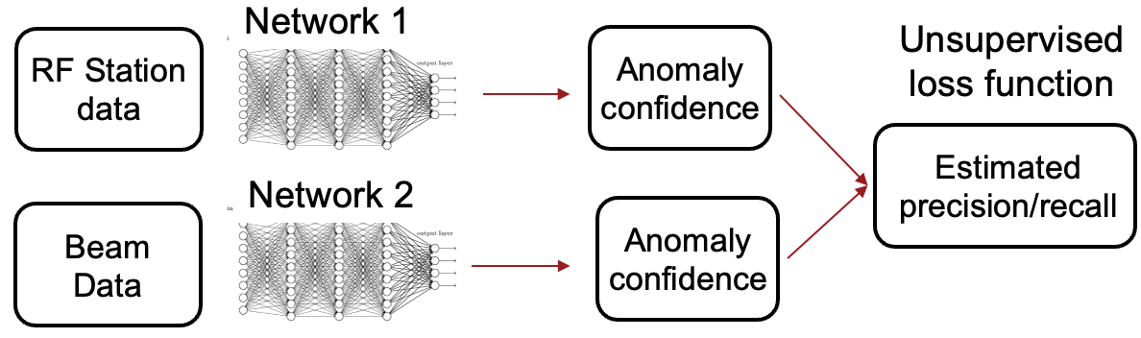
Anomaly detection: Facility prognostics use case
Example: RF station faults
RF stations provide power for acceleration
Most common fault at LCLS (1000s/year)
Degrades performance even if no downtime
Years of data, only dozens labeled
AI solution:
Neural networks trained to identify coincidence between beam and sub-system
50% better recall, 6x fewer false positives vs. SoTA (70% false positive → 15% false positive)
SLAC Linear Accelerator and 280 Overpass
SLAC RF Stations

Slide 17
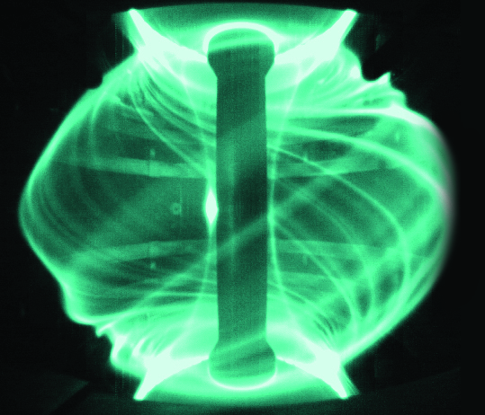
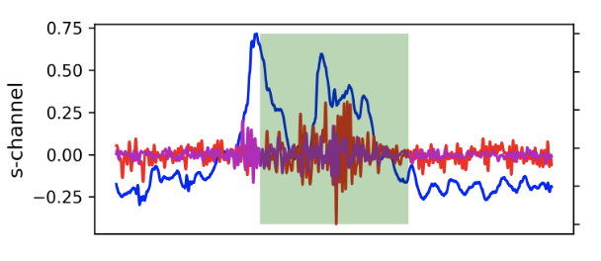
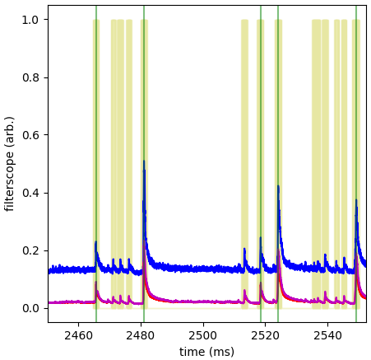
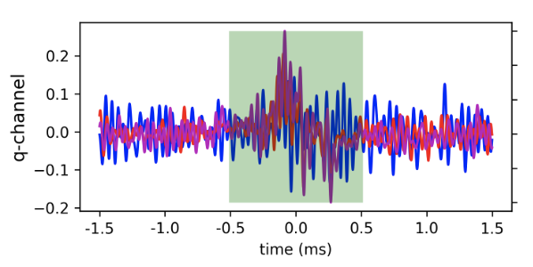
Anomaly detection: Physics discovery (ELMs)
Challenge: Identify edge-localized modes (ELMs) in tokomaks
ELMs result in beam loss and potential catastrophic damage
Terabytes of data, but mostly unlabeled
SoTA classical methods known to have recall <50%
Fusion-cdt
Green lines: existing State-of-art
Interferometers,
beam emission spectroscopy
Yellow bands: DNN trained with coincidence
Filterscopes
F. O’Shea

Slide 18
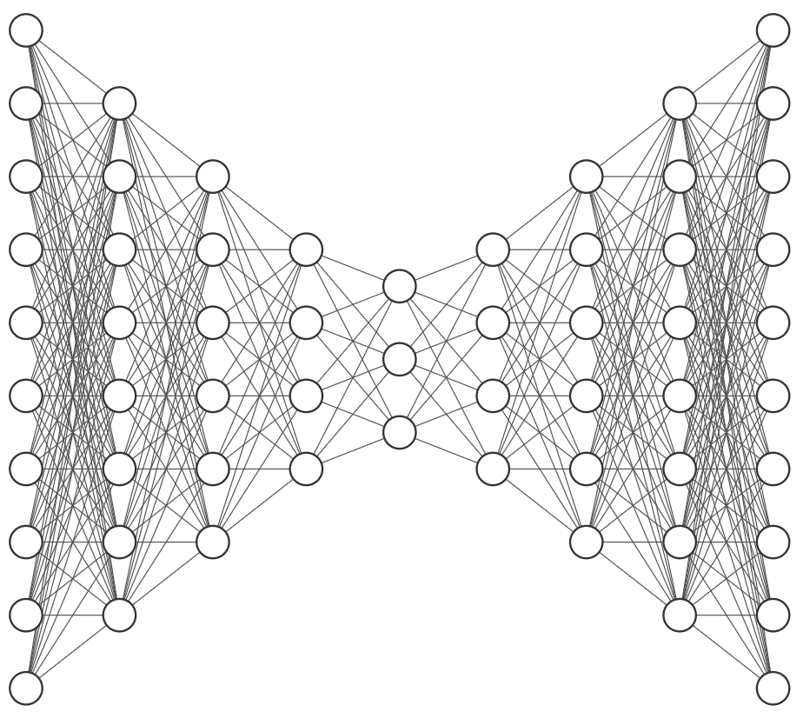
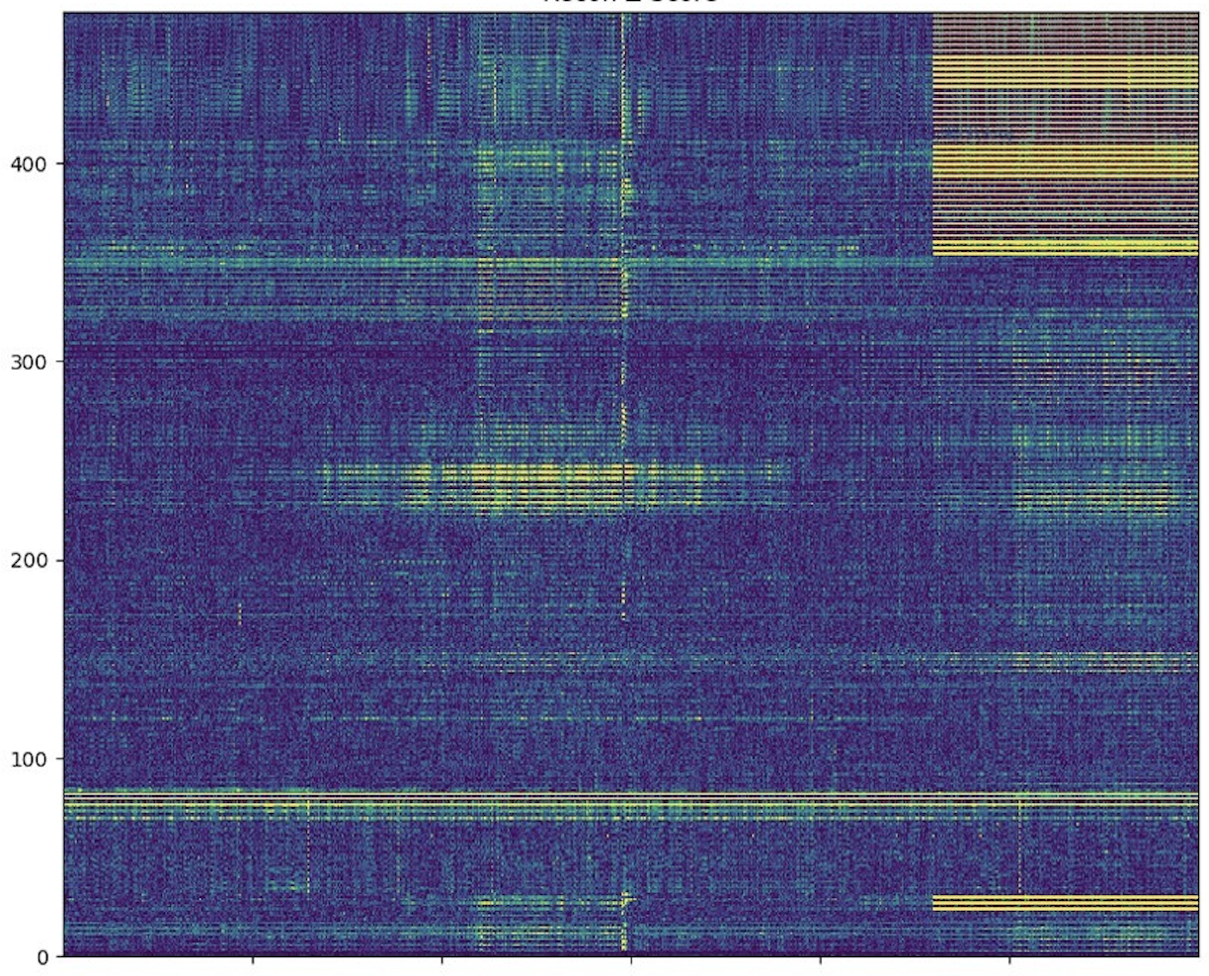
Anomaly detection: Autoencoders
NN Autoencoder solution
Training step: train on auto-encoder on “normal data” (ideally without any anomalies)
Inference can use two methods
  Reconstruction error indicates sample from a new (i.e. anomalous) distribution
  Normal examples map to central portion of latent space. Distance in latent space then indicates anomalous behavior
Input
Output
Latent space
Accelerator diagnostics
Accelerator diagnostics
Reconstruction error
|Output – Input|
Diagnostics
Ryan Humble
Time (~1 minute)

Slide 19
Outline
Surrogate models
Optimization
Anomaly detection
Reconstruction/Inverse problems
Large language models

Slide 20
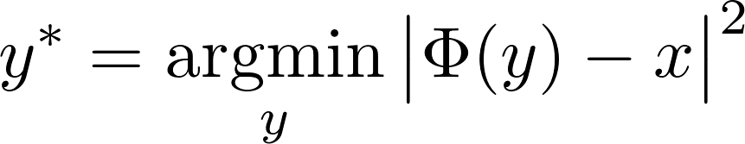
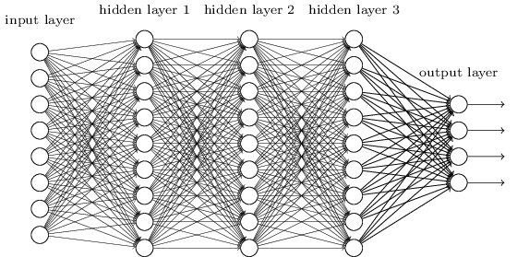
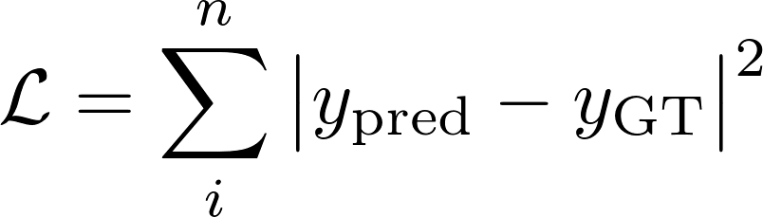
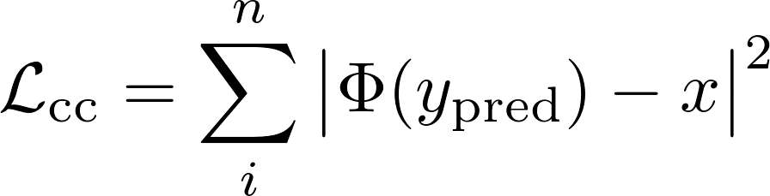

Inverse problems: AI methods
Challenge: How to solve a repeated inverse problem?
X
Φ
Y
?
Inputs
Target
1. Solve optimization problem:
2. Train a neural network:
x
y
3. Train a cycle-consistent neural network:
x
y
Caveat: Φ must be differentiable!
Φ

Slide 21
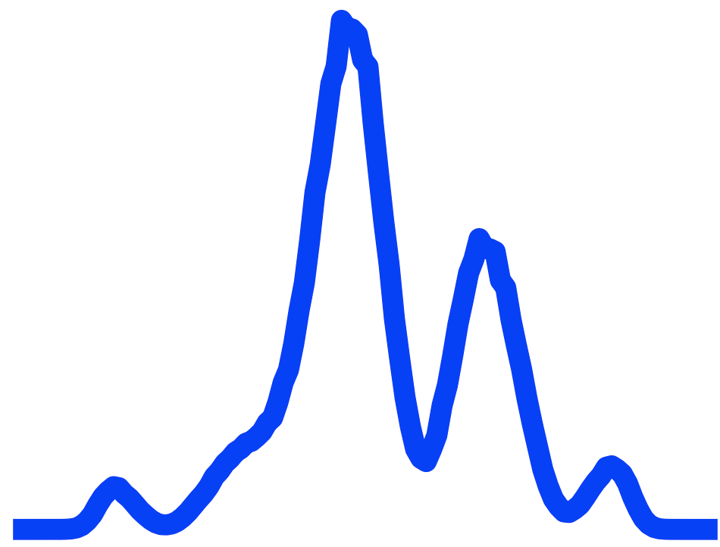
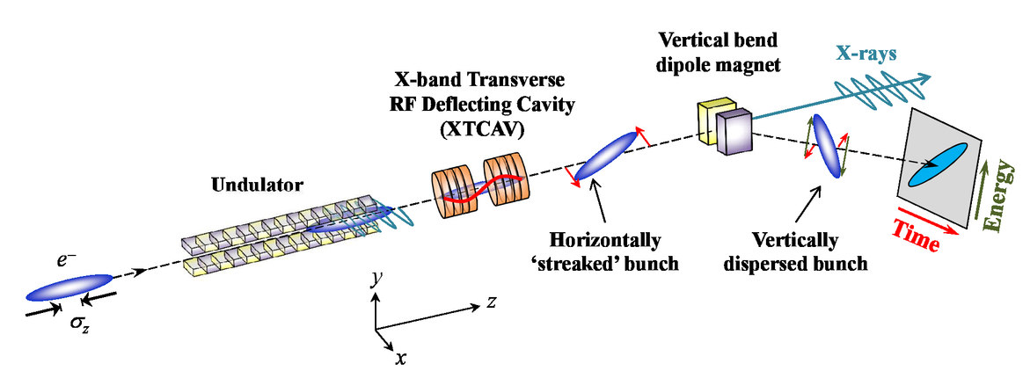
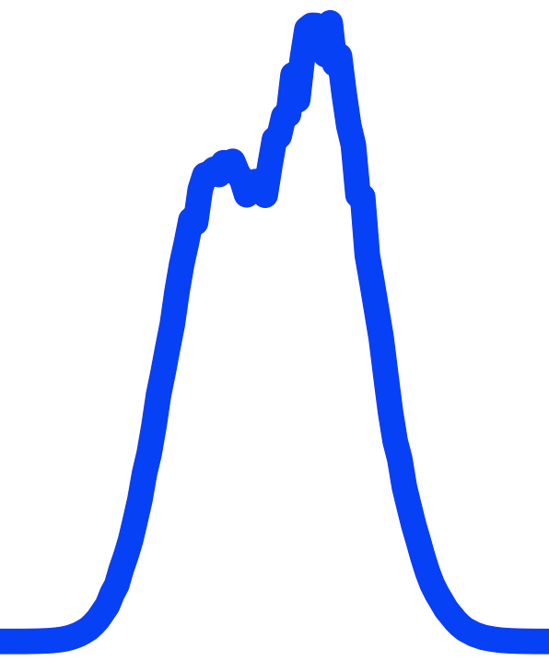
Inverse problems: Pulse reconstruction use case
Challenge: Given measured amplitude of power/spectrum at an x-ray free electron laser (XFEL), how to recover high-resolution field?
SoTA Problems:
Iterative inverse solver: guess solution and check
Too slow for a MHz XFEL, large phase errors
Input spectral power points (80meV FWHM resolution)
AI solution
NN solver is million fold faster at inference time
First consistent phase recovery
Spectrum
Input power points
(3fs FWHM resolution)
power
Maxwell, Timothy J., et al. International Society for Optics and Photonics, 2014.

Slide 22
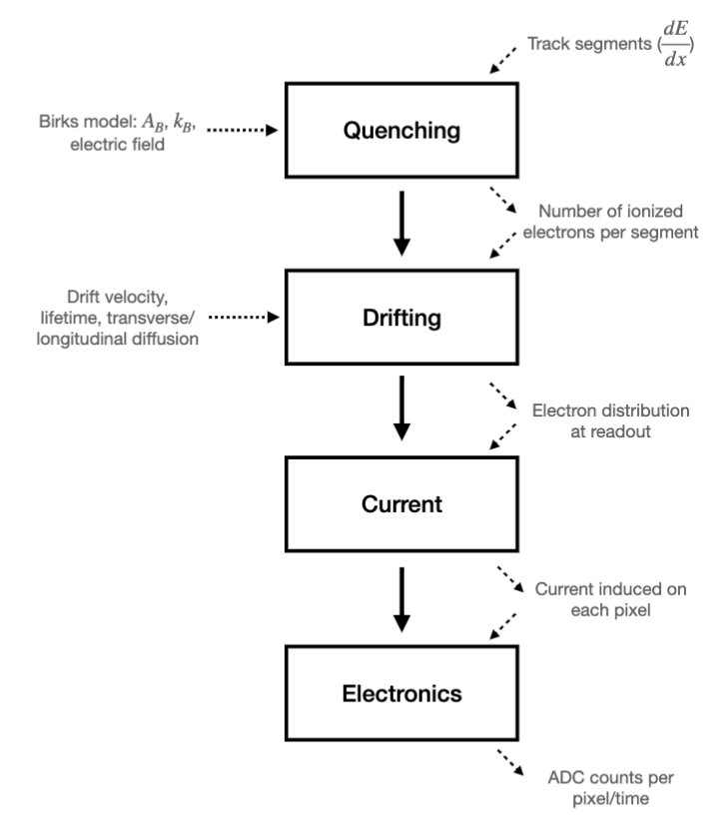
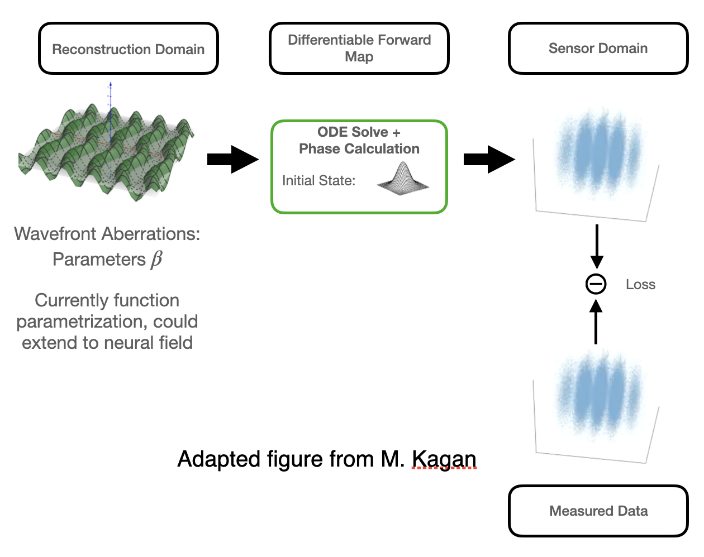
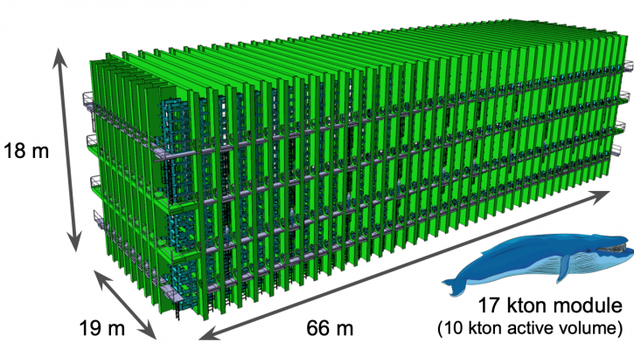
Inverse problems: differentiable simulations
Key requirement for PINNs/cycle-consistent NN: differentiable simulator
LArTPC (e.g. DUNE) simulator:
MAGIS-100 simulator
S. Gasiorowski, Y. Nashed, Y. Chen, K. Terao et al.
Cheong, Sanha, et al (2022)

Slide 23
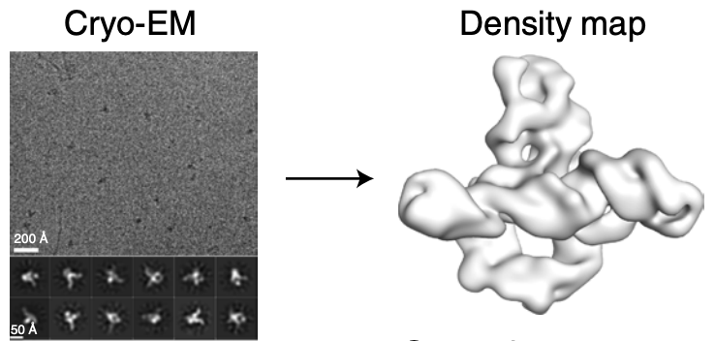
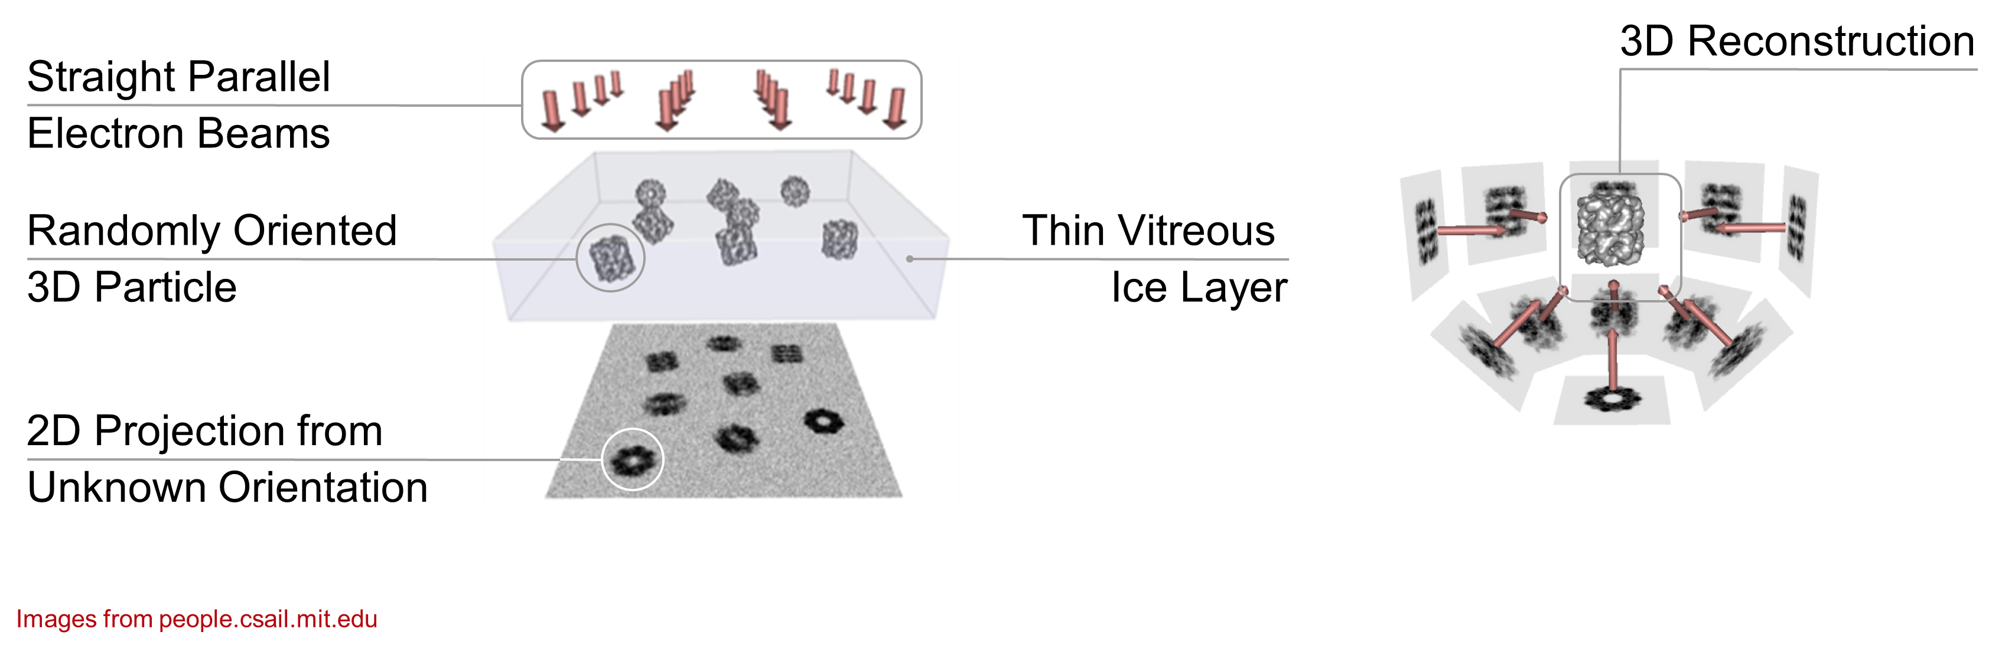
Inverse problems: Single-particle imaging
Single-particle imaging of biomolecules with Cryo-EM:
Structures for un-crystallizable proteins/RNA
Closer to in-vivo than a crystal
Access to conformations not just average structures
Kappel et al.
Greg Pintilie

Slide 24
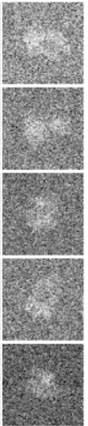
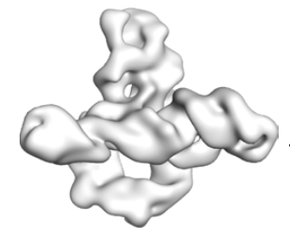
Inverse problems: Single-particle imaging
Recast as a repeated inverse problem:
A million images ➔ a million inverse problems
Each image requires pose and conformation estimation
Pose
Density map
Φ

Slide 25
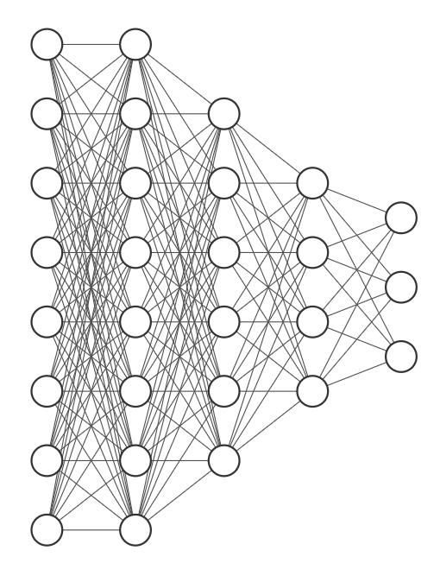
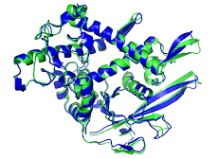
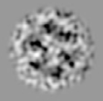
Inverse problems: Single-particle imaging
Recent work: directly learn atomic model conformations on data
Parametrize atomic model with normal mode analysis (NMA)
Train encoder network to map each image to a point in NMA space
Differentiable simulation maps NMA space to atomic model to microscope image
spliceosome
Forward model
Encoder network
Latent NMA representation
Output
Input
Conformation Space
NMA
Decoder
Microscope Digital Twin
Orientation Space
Learn network/model parameters by minimizing the difference between input and output images
Y. Nashed, F. Poitevin, et al., submitted (2024)

Slide 26
Inverse problems: Single-particle imaging
First experimental results on spliceosome:
Fitting 16 normal modes, 140k particles, 128x128 images
Uncertainties from cross-validation (2 partitions)
Absolute error
NMA latent space
Observed motion
A
Signal-to-noise
Y. Nashed, F. Poitevin, et al.

Slide 27
Outline
Surrogate models
Optimization
Anomaly detection
Reconstruction/Inverse problems
Large language models

Slide 28
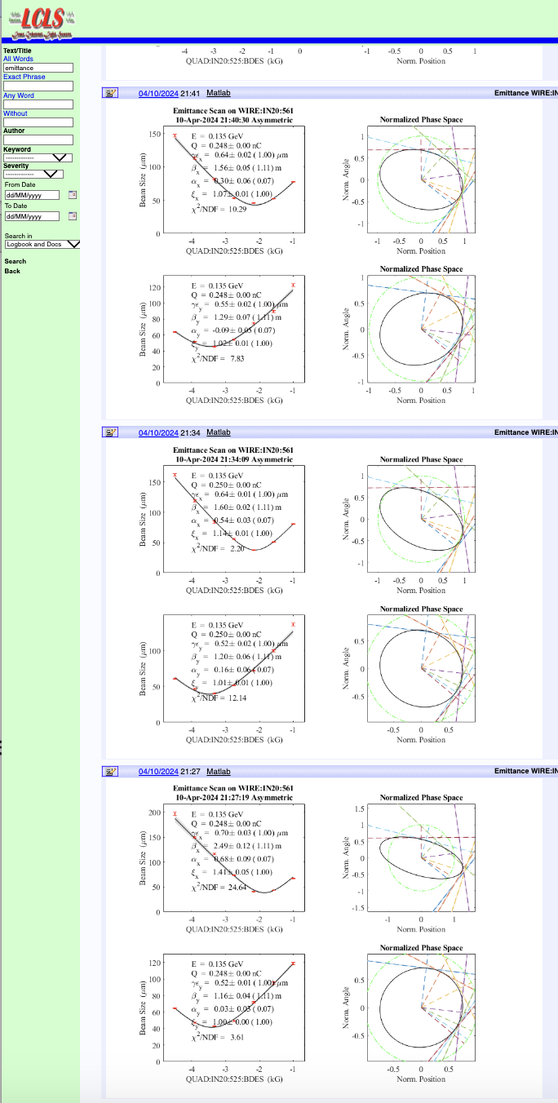
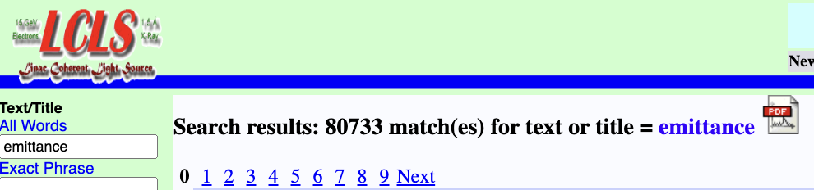
Large language models: Logbooks
Challenge: How to capture value of scientific documents (papers, logbooks, notebooks, wikis, etc)?
“What is typical uncertainty of emittance measurements?"
AI solution:
Large language models (LLMs) are adept at natural language queries
Complex queries of logbooks
Generation of novel text (e.g. shift summaries)
Meta-data generation
Status:
Early demonstrations, state-of-art is changing fast
More development needed for multimodal data, domain-specific data sources, etc.

Slide 29
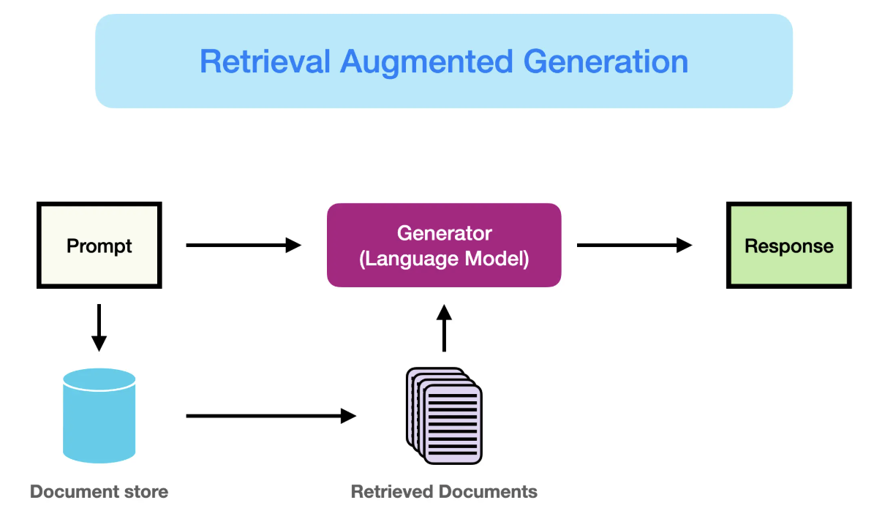
Large language models: Retrieval augmented generation
AI methods: Scientific language is highly specialized and may not be represented in generic LLMs. Two options:
Fine-tuning: Retrain using domain science texts. But expensive: requires data prep and compute
Retrieval Augmented Generation (RAG): Select “small” portion of relevant texts to use as context.
Train an embedding on domain science texts
Learn embedding of all domain documents
For each query, select most relevant text (nearby in embedding space)
Feed relevant text as context along with prompt to generic LLM.
Courtesy Prompt Engineering Guide

Slide 30
Thanks for your attention!
Caveat: This is just a taste of applications, far from a comprehensive review!
Thanks to collaborators:
Alex Bien, William Colocho, James Cryan, Joe Duris, Eric Darve, Auralee Edelen, Ryan Humble, TJ Lane, Siqi Li, Dylan Kennedy, Jason Liang, Alberto Lutman, Matt Gibbs, Xiaobiao Huang, Sara Miskovich, Willie Neiswanger, Finn O’Shea, Ryan Roussel, Zhe Zhang

Slide 31
Backup
Notes:
Histogram of the events based on the change in RF amplitude. Orange were labeled anomalous by our algorithm. A simple threshold at ~5 would have significant differences (about 20%) from our NN prediction. Based on visual inspection and correlation efficiency, we believe the NN is mostly correct (~10% errors).

Slide 32
Anomaly detection: Edge-localized modes
Challenge: Identify edge-localized modes (ELMs) in tokomaks
ELMs result in beam loss and potential catastrophic damage
Terabytes of data, but mostly unlabeled
SoTA classical methods known to have recall <50%
Fusion-cdt
Green lines: existing State-of-art
Interferometers,
beam emission spectroscopy
Yellow bands: DNN trained with coincidence
Filterscopes
F. O’Shea

Slide 33
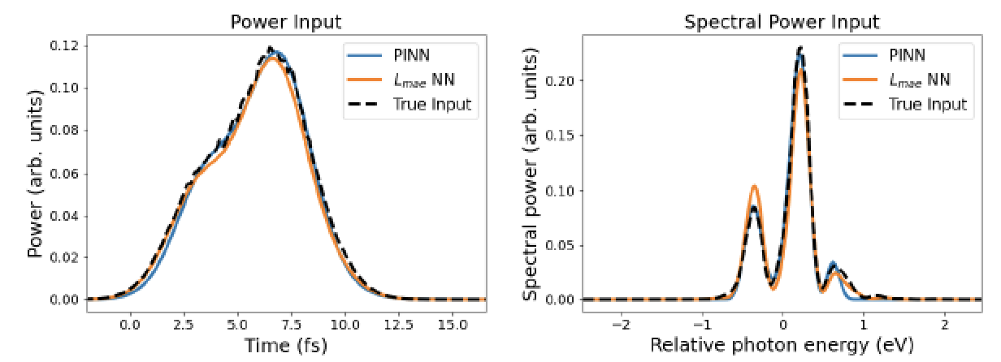
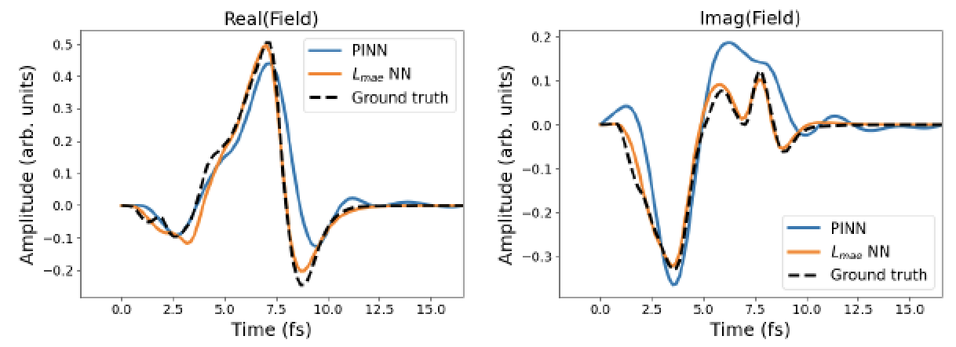
X-ray Pulse Reconstruction
Inverse problem: Full beam reconstruction
Advantages: 10⁸ faster, higher accuracy on amplitude and phase compared to iterative method
D. Ratner et al., Opt. Exp., 2021

Slide 34


Anomaly Detection: RF Station Faults
Existing solution #1: Thresholding on subsystem amplitudes
Readbacks of station power condensed to “status bit” for each of 80 stations
Status bit ‘0’ if healthy, and flips to ‘1’ if RF amplitude changes more than 2%
RF station amplitude for 1 station
RF station diagram
Status bit has multiple problems:
Too simplistic (only looks for sudden drops)
Too permissive (misses subtle faults)
Too noisy (lots of false positives)
7 example measurements
70% of alarms are false
(i.e. poor precision)
0
Time (min)
5
Recall = TP/(TP+FN) Precision = TP/(TP+FP)
TP = true positive, FP = false positive, FN = false negative

Slide 35


Anomaly Detection: RF Station Faults
Existing solution #2: Manual, beam-based anomaly detection
After observing a drop, search for RF stations with warning/fail status
Operators watch for a drop in X-ray power here
Many missed events
(recall ~ 1%)

Slide 36



Anomaly Detection: RF Station Faults
New approach: Beam-based algorithm inspired by operators
Highway 280
RF stations
Beam position monitors
Question: How do we train these algorithms with no labels?
Algorithm #1 looks for subsystem anomalies
Algorithm #2 looks at final beam quality
Key insight: A ‘good’ pair of algorithms will be self-consistent
Simultaneous anomalies trigger alarm

Slide 37

Coincident Anomaly Detection (CoAD)
Consider two algorithms making predictions on two streams of data
Subsystem
Algorithm 1
Prediction
Self-Consistency
metric
Unknown
machine state
Beam quality
Algorithm 2
Prediction
Subsystem (s)
Red stars = consistent
black stars = inconsistent
More red = higher recall;
less black = higher precision
Anomaly
confidence
Quality (q)
FP rate = product of black star rates
Anomaly
confidence
TP rate = red star rate – FP rate
➔ Unsupervised precision/recall

Slide 38







Coincident Anomaly Detection (CoAD)
Consider two algorithms making predictions on two streams of data
We estimate unlabeled version of recall/precision from coincidence
Estimates can be differentiable ➔ can train neural networks!
i.e. a loss function, not just a metric
Formally the loss function is defined for NN outputs :
: red star rate
: estimated FP rate
: Estimated anomaly rate
: Weighting factor (recall vs. precision)

Slide 39


CoAD for RF Station Faults
Implementation for RF station task:
Network 1
Unsupervised loss function
RF Station data
Anomaly confidence
Estimated precision/recall
Network 2
Beam Data
Anomaly confidence

Slide 40


Case Study 1: Performance in the control room
Summary of predictions on 4 months of data
 | Precision | Recall (events)
Manual recording by operator | NA | 6
Status bit | 0.31 | 385
Coincident Detection | 0.88 | 504
100x more anomalies vs. manual recording
30% more anomalies vs. status bit
6x fewer false positives vs. status bit
Live deployment in LCLS control room!
RF
Amplitude
BPMs
Ryan Humble, Finn O’Shea, Zhe Zhang

Slide 41





Inverse problems: X-ray Pulse Reconstruction
Approach #2: Train a labeled neural network
Simulated Output
SimulatedInput
field
Labeled loss,
NN Inverse Model
field
power
Predicted Output
Spectrum
Problem: absolute phase is meaningless!
D. Ratner et al., Opt. Exp., 2021

Slide 42




Inverse problems: X-ray Pulse Reconstruction
Approach #3: Train a neural network with cycle-consistent loss
“Physics-informed neural network” (PINN)
Advantages: No need for labeled data, train directly on experimental data
Predicted Input
Input
Φ
NN Inverse Model
field
power
Physics forward model, Φ
power
Predicted Output
Spectrum
Spectrum
Unlabeled loss,
D. Ratner et al., Opt. Exp., 2021

