Slide 1
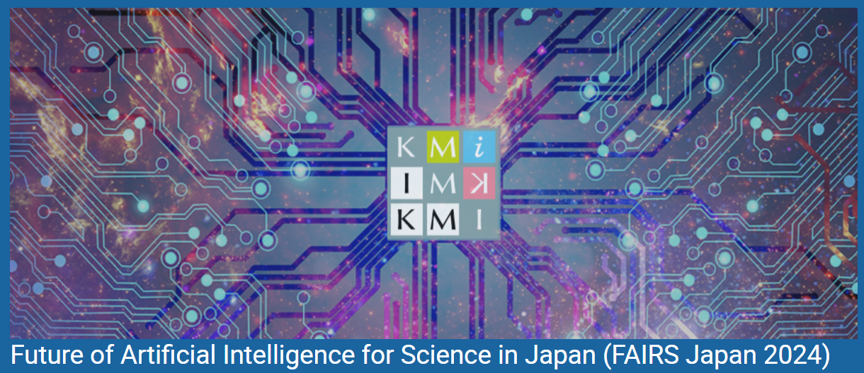
AI/ML in Accelerator Physics
December 3rd, 2024
Hirokazu Maesaka
RIKEN SPring-8 Center
On behalf of the AI/ML community in the accelerator domain

Slide 2
Introduction
Particle accelerators have good compatibility with AI/ML.
The design of an AI/ML tool is easier if the goal is clear.
  Physics researchers usually look for new phenomena, so the goal is sometimes unclear.
  Black-box AI/ML algorithms are not suitable to reveal underlying physics.
  Particle accelerators are usually designed and constructed with a given goal, such as beam energy, intensity, stability, …
Since the goal of a particle accelerator is well-defined, we have good motivation to develop AI/ML tools.
Recently, the required performance has become difficult to realize, fine-tuning with try-and-error is necessary to optimize.
  A certain performance can be obtained by adjusting the accelerator based on the physics model, but it is often not the best.
  An AI/ML method helps us to achieve the best performance ever experienced.
  We can easily evaluate the performance of an AI/ML method from the output.
Automatic operation, failure prognosis, etc. are also important for stable operation to maximize the research outcomes.
  Operators can concentrate on complex problems by relying on AI/ML tools for relatively simple tasks.
  This situation would be helpful in accomplishing better performance.

Slide 3
AI/ML activities in the accelerator domain
Application of AI/ML techniques to accelerators started about ten years ago.
Workshops on machine learning applications for particle accelerators have been held since 2018.
  SLAC (2018), PSI (2019), BNL (2022), PAL (2024), CERN (2025)…
  https://malapa.org/
Many successful results have been demonstrated.
  Bayesian optimization, mainly with Gaussian process optimizers.
  Advanced analyses, such as the reconstruction of a complex phase-space distribution.
  Surrogate models to reproduce the response to each input parameter without a time-consuming tracking simulation.
  Failure prognosis and anomaly detection for stable operation.
Other advanced AI/ML techniques are also actively studied.
  Reinforcement learning for better performance optimization.
  Transformer models to analyze and predict time-series data.
  Acceleration of particle beam simulations with AI/ML-based methods.
  And many others…

Slide 4
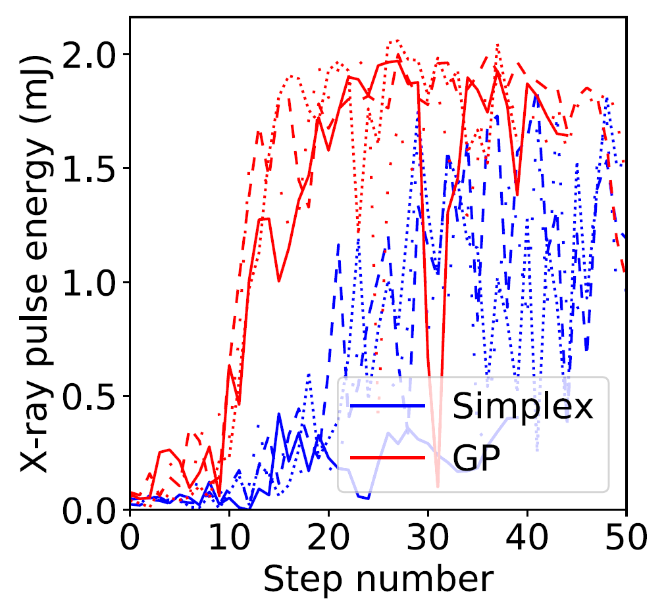
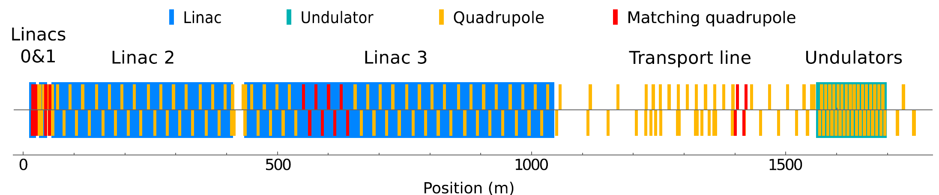
XFEL pulse energy optimization at LCLS
J. Duris et al.,. Phys. Rev. Lett. 124, 124801 (2020)
The first application of a Gaussian process optimizer was XFEL pulse energy optimization at LCLS SLAC.
They demonstrated that the Gaussian process optimizer performed better than conventional optimizers, such as Nelder-Mead simplex.
Optimization of XFEL pulse energy over 12 Quadrupole strengths in comparison with the Nelder-Mead simplex.

Slide 5
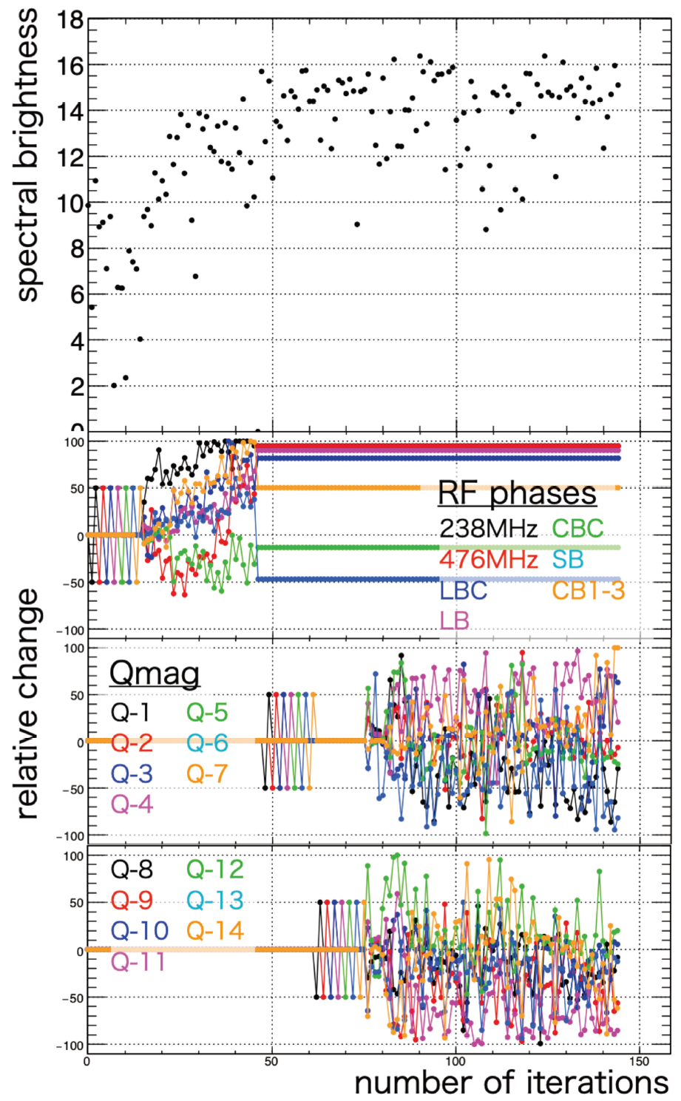
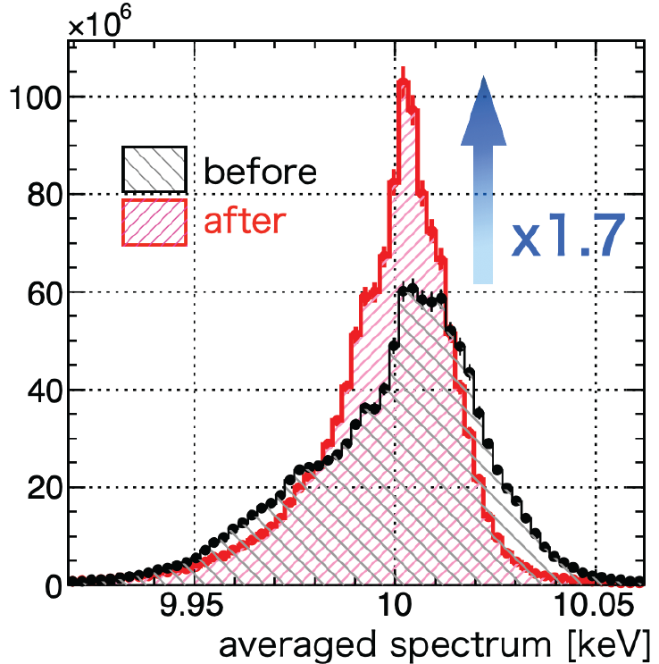
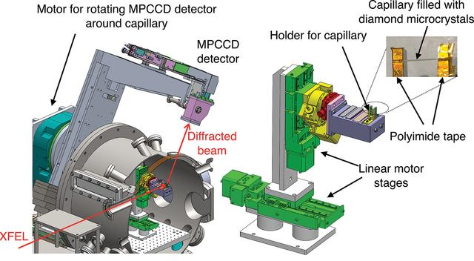
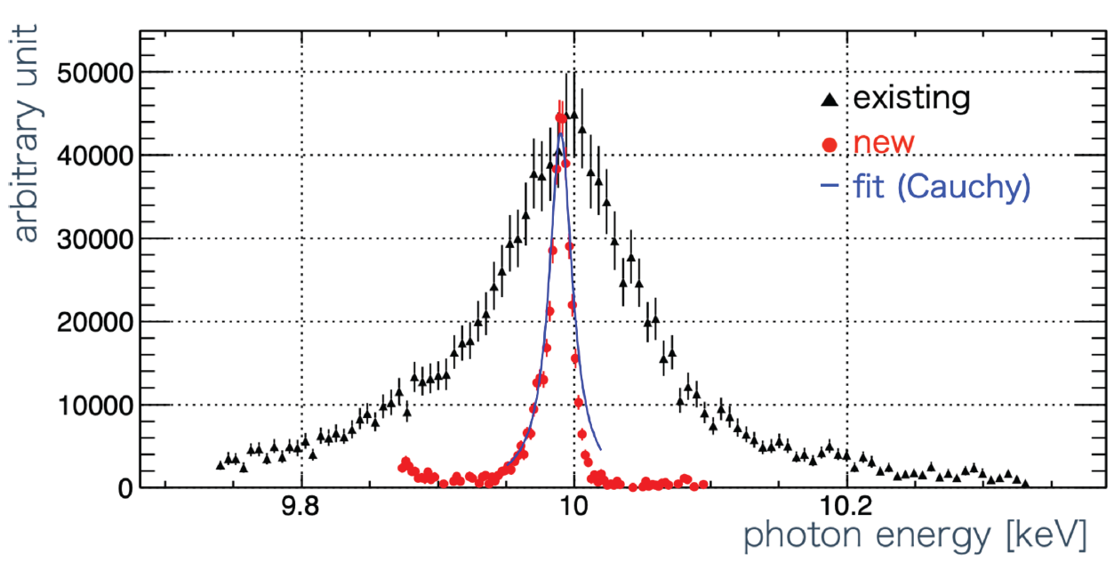
Spectral brightness optimization in SACLA
E. Iwai et al., J. Synchrotron Rad. 30, 1048–1053 (2023).
I. Inoue et al., J. Synchrotron Rad. 29, 862–865 (2022).
We developed a new high-resolution inline spectrometer.
The intensity of the spectral peak region was maximized by a Gaussian process optimizer.
Tuning knobs are RF phases, quadrupole strengths, undulator K-values, etc.
Visit my poster for details.

Slide 6
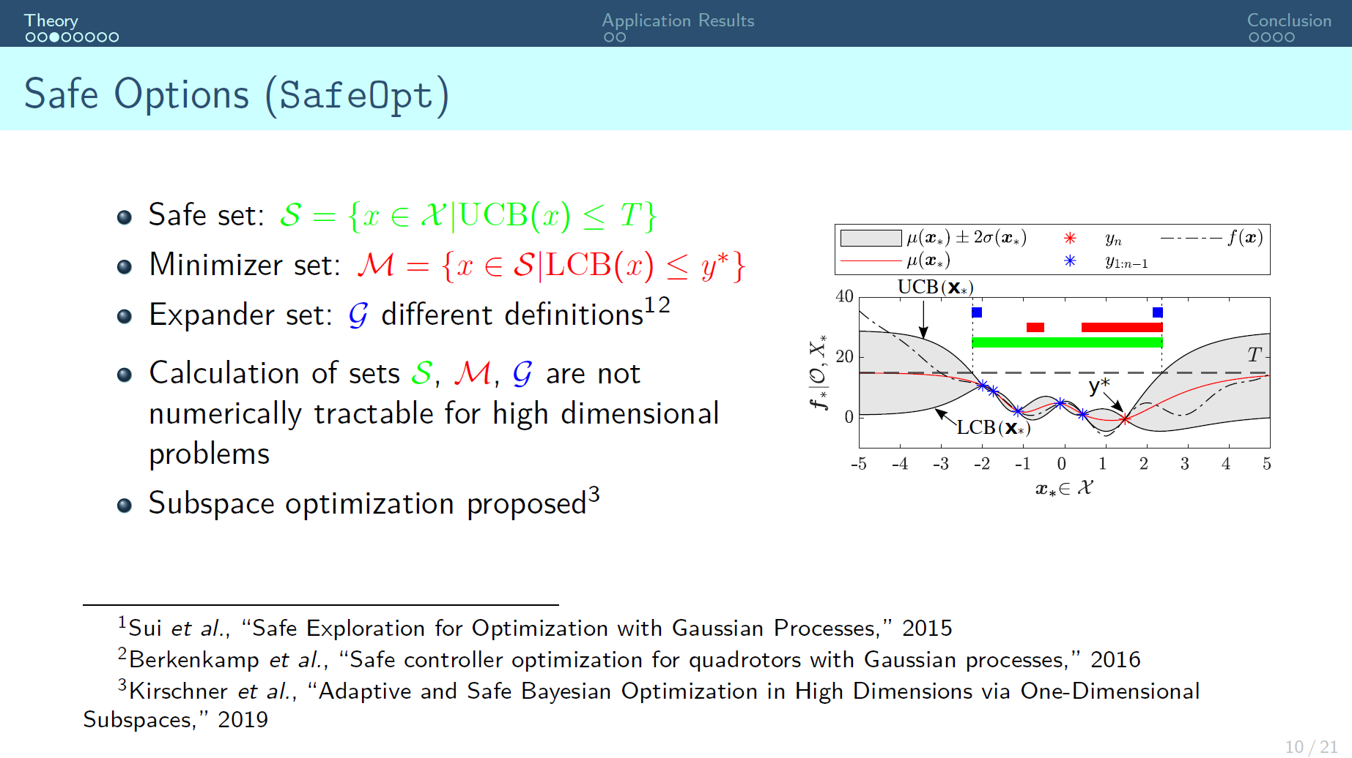
A. Eichler et al., “A save Bayasian optimization for tuning the optical synchronization system at European-XFEL”, Malapa’24.

Slide 7
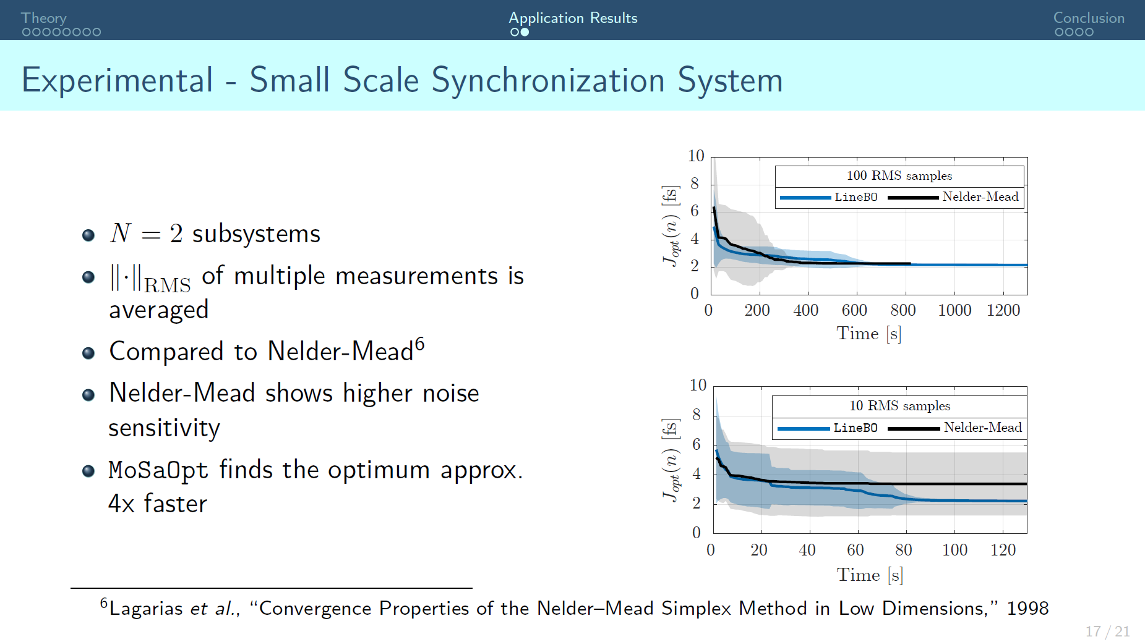
A. Eichler et al., “A save Bayasian optimization for tuning the optical synchronization system at European-XFEL”, Malapa’24.

Slide 8





Useful Gaussian process optimizer tools
General Gaussian process tools
  Scikit Learn: https://scikit-learn.org/
    Plenty of machine learning tools
  BoTorch: https://botorch.org/
    Bayesian optimization tool built on PyTorch
  GPyTorch: https://gpytorch.ai/
    Gaussian process inference tool built on PyTorch
Gaussian process optimizer for accelerators
  Xopt: https://github.com/xopt-org/Xopt
  Badger: https://xopt-org.github.io/Badger/
  APSopt: N. Kuklev et al., IPAC’24, TUPS50.
  GeOFF: https://zenodo.org/records/8434513
  SACLA optimizer: E. Iwai et al., J. Synchrotron Rad. 30, 1048–1053 (2023).
GPyTorch

Slide 9
ML/AI-based phase-space reconstruction
The phase-space distribution of particles is important to understand the quality of the accelerated particle beam.
  We can accurately estimate the beam profile at any point from the phase-space distribution at a given point.
  Usually, we can measure only the spatial profile directly.
  However, both spatial and angular profiles are needed for the phase-space reconstruction.
Recently, a complex phase-space distribution has been reconstructed by using an ML/AI-based method.
Ryan Rousell et al., Phys. Rev. Lett. 130, 145001 (2023).
Phase Space Reconstruction from Accelerator Beam Measurements Using Neural Networks and Differentiable Simulations
Adi Hanuka et al., Scientific Reports 11, 2945 (2021).
Accurate & Confident Prediction of Electron Beam Longitudinal Properties using Spectral Virtual Diagnostics

Slide 10
Phase-space reconstruction pipeline
Ryan Rousell et al., Phys. Rev. Lett. 130, 145001 (2023).

Slide 11
Experimental results from AWA
AWA: Argonne Wakefield Accelerator
Ryan Rousell et al., Phys. Rev. Lett. 130, 145001 (2023).
Reconstruction of 4D phase-space distribution

Slide 12
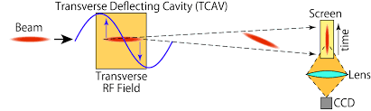
ML-based Virtual Diagnostics (VD) of Longitudinal Phase-Space (LPS)
Adi Hanuka et al., Scientific Reports 11, 2945 (2021).

Slide 13
Spectral Virtual Diagnostic (VD)
Adi Hanuka et al., Scientific Reports 11, 2945 (2021).

Slide 14
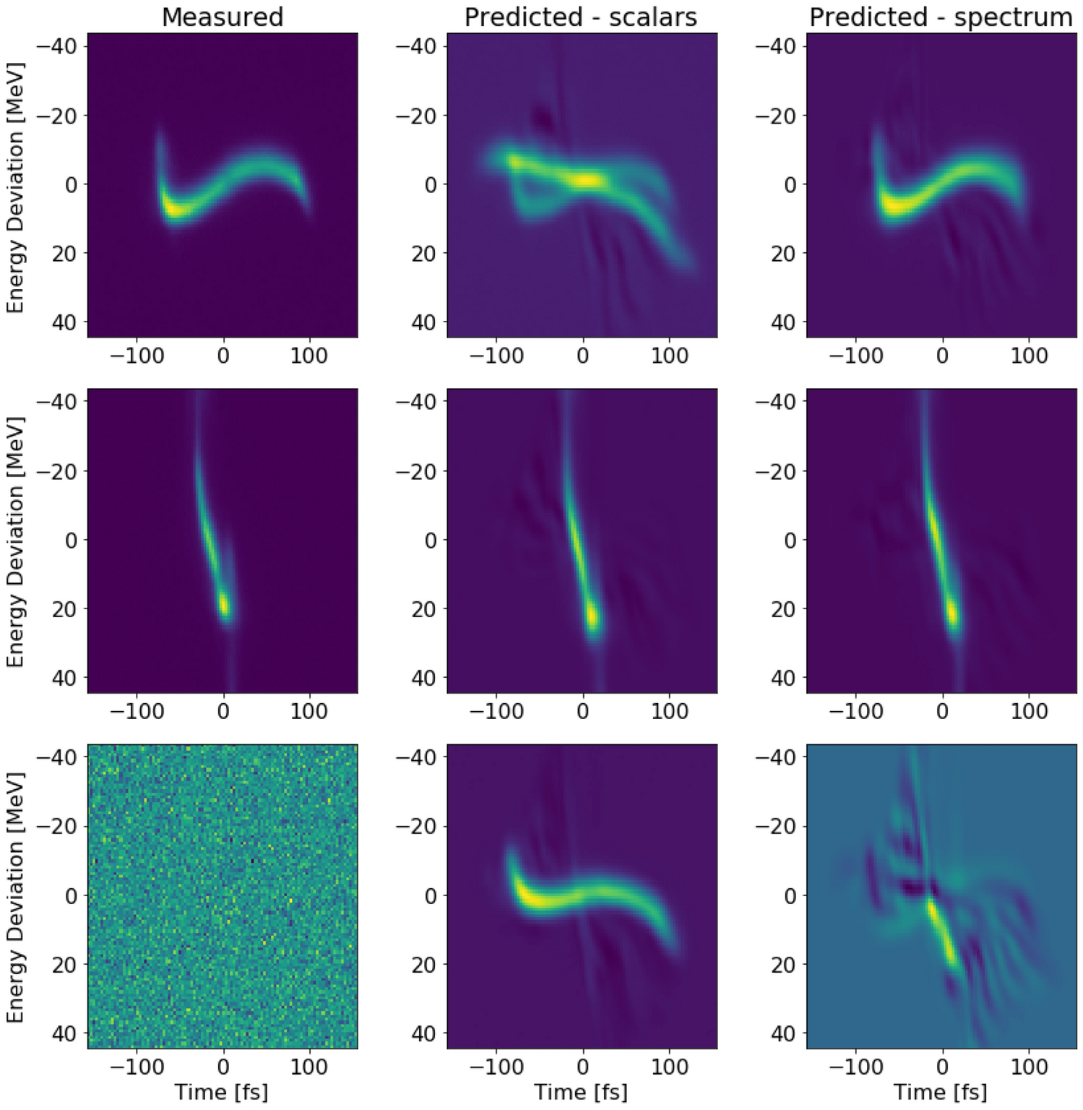
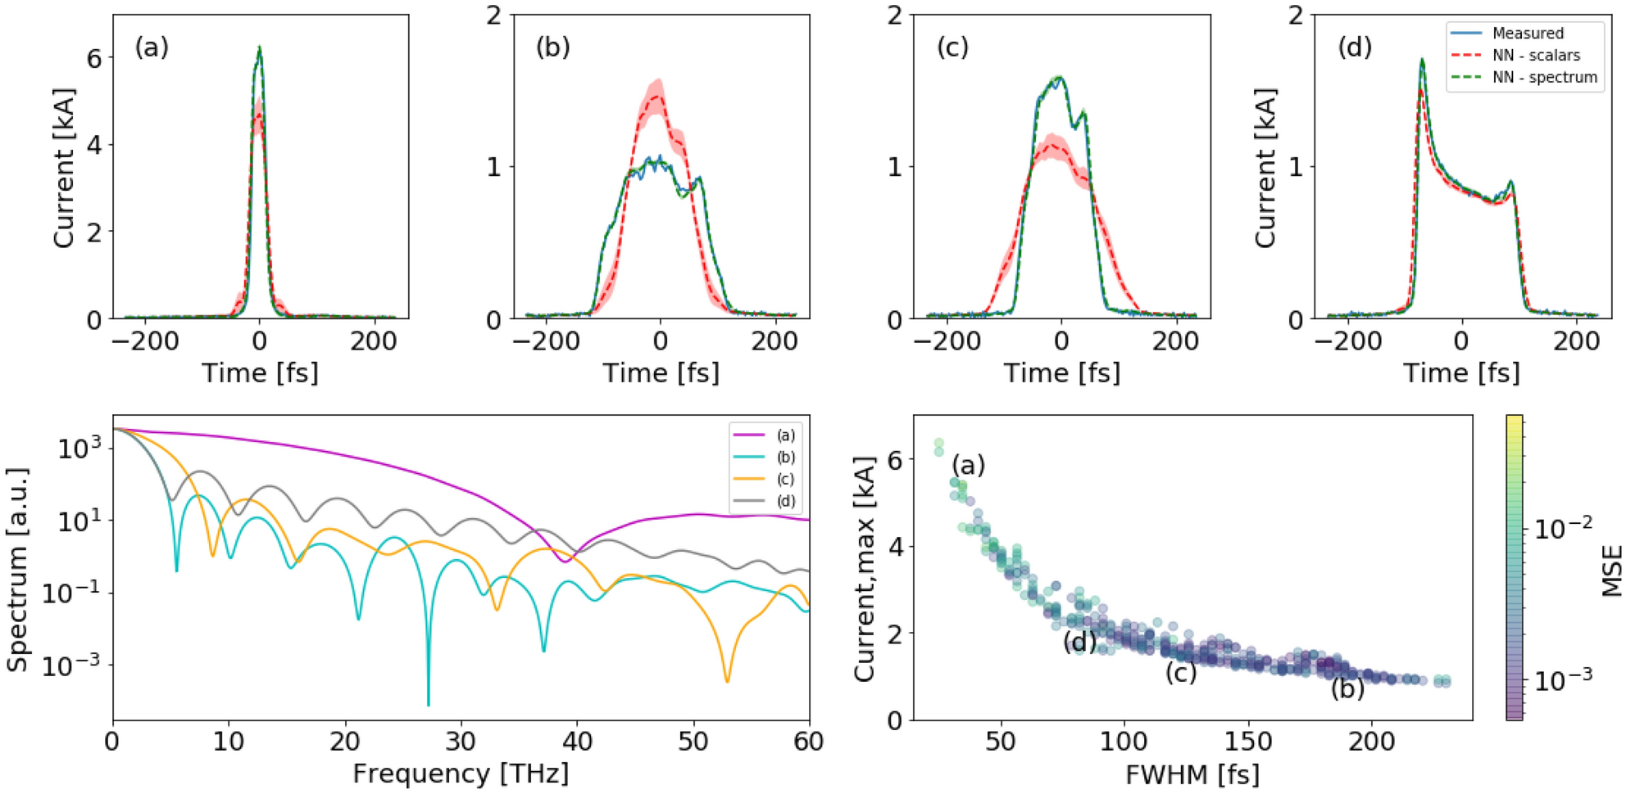
Results from LCLS
Longitudinal phase-space distributions
Current profiles
Adi Hanuka et al., Scientific Reports 11, 2945 (2021).

Slide 15
Surrogate models
A particle tracking simulation takes a long time and consumes computer resources very much.
A surrogate model based on deep neural networks (DNN) can resemble the simulation very fast.
  DNN can be accelerated by GPGPU.
Axel Hubel et al., “AI/ML Coupling & Surrogates in BLAST Accelerator Modeling Codes”, MaLaPa’24.
  Slides under CC-BY 4.0, DOI:10.5281/zenodo.10791261

Slide 16
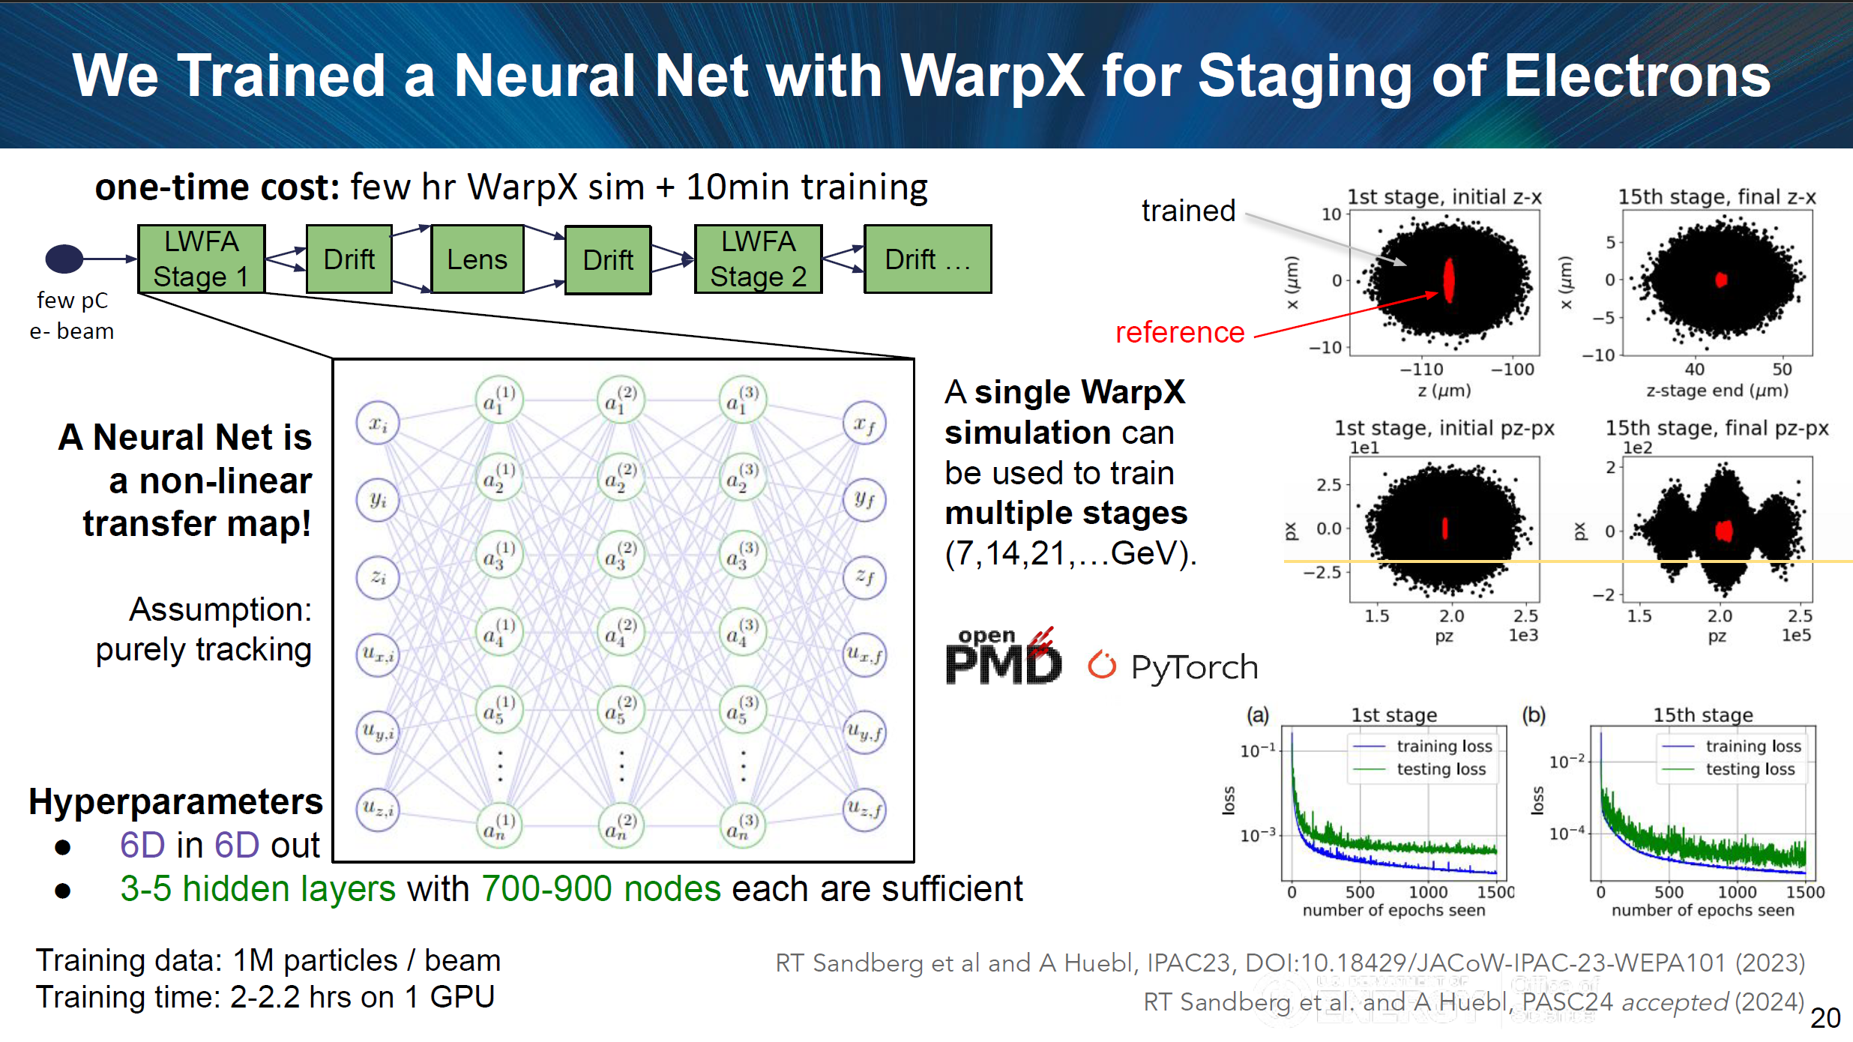

Slide 17
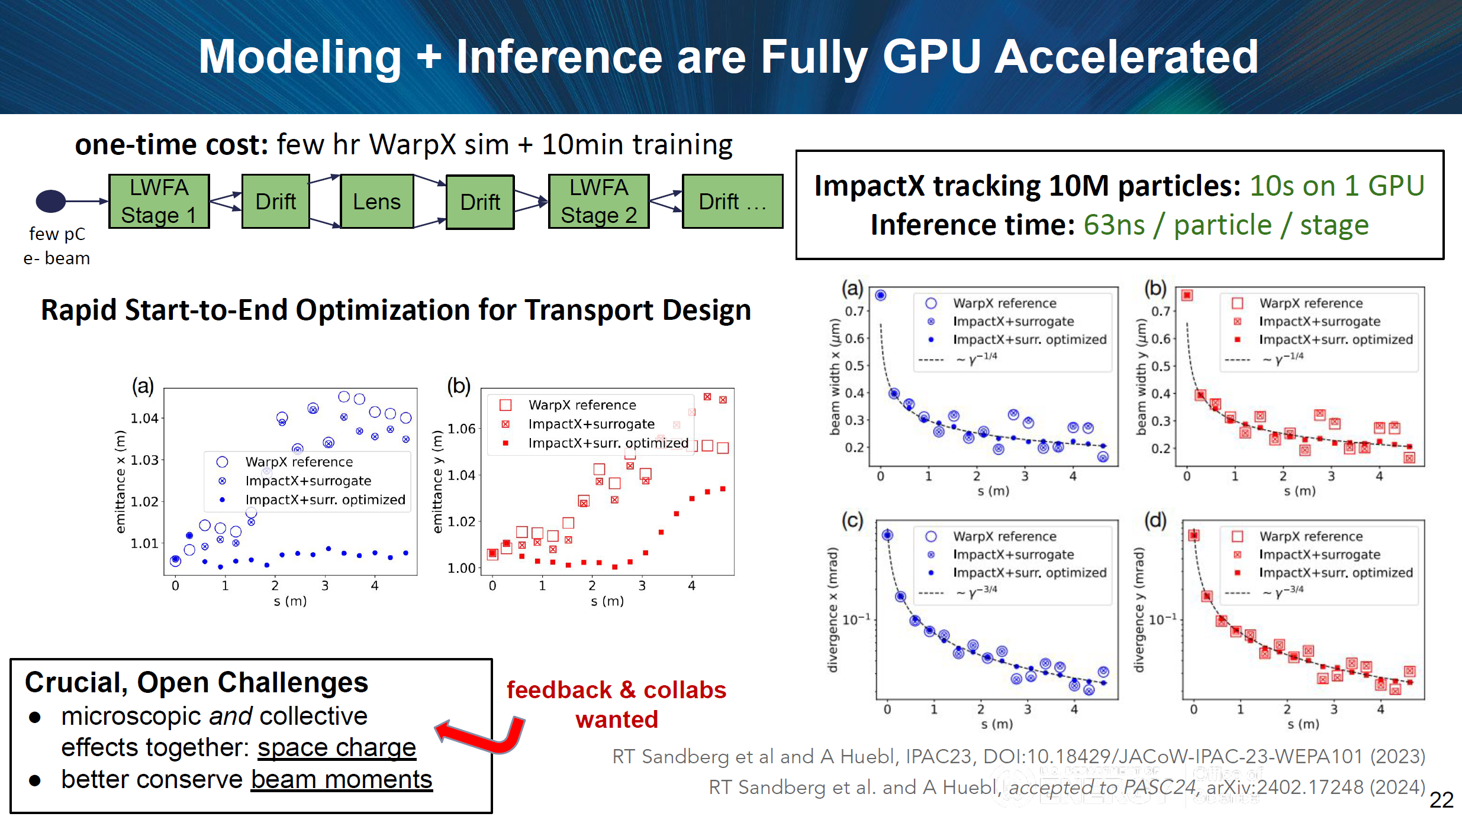

Slide 18
Failure prognosis
Conventional fault detection
An ML-based fault detection can be helpful for the stable operation of an accelerator.
An accelerator has many high-power components and precise electronics, likely to cause malfunctions.
It is important to detect a precaution before a fatal situation.
An ML-based failure prognosis method learns the normal state of a device and activates a precaution if an abnormal value is observed.
This precaution enables us to continue the accelerator operation by preventive repair.
Alarm!!
Threshold
Time
ML-based fault detection
Alarm!!
Time

Slide 19
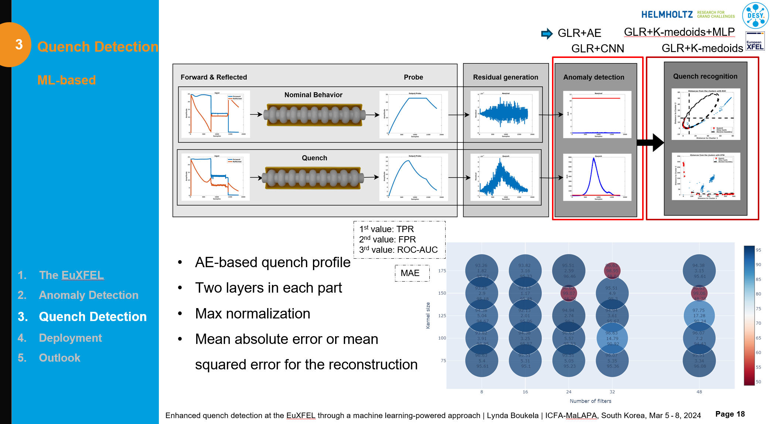
GLR: Generalized Linear Regression
MLP: Multi-Layer Perceptron
AE: Auto-Encoder

Slide 20
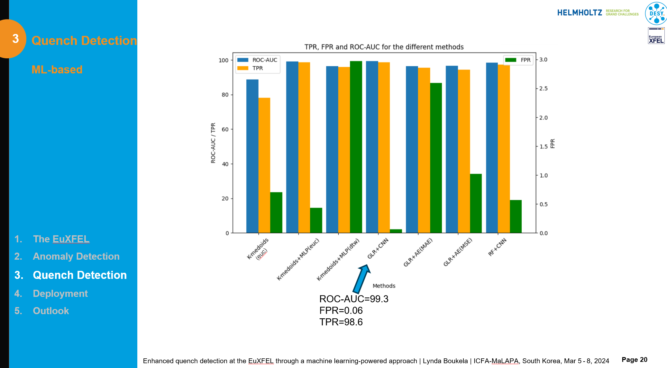
ROC: Receiver Operating Characteristic curve
AUC: Area Under the Curve
TPR: True Positive Rate
FPR: False Positive Rate

Slide 21
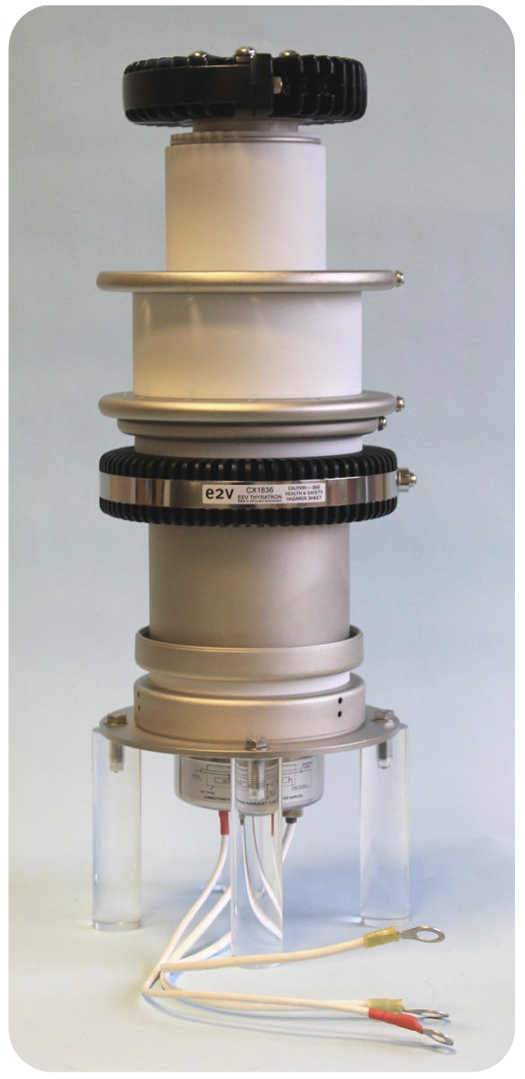
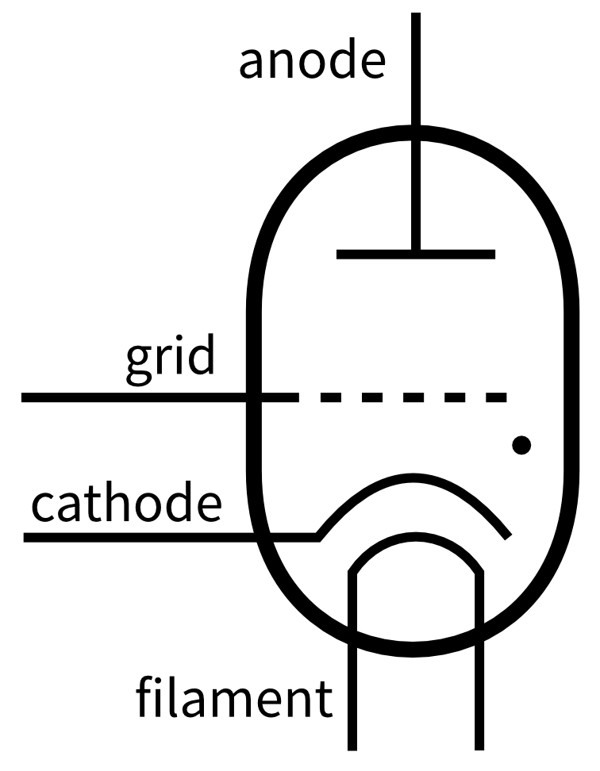
Anomaly detection of thyratron discharge rate
A thyratron is a gas-fill tube used as a high-voltage and high-power switch.
The average lifetime of the thyratron is about 20,000 hours (a few years), which is relatively shorter than the other high-power devices.
The operation of SACLA is often suspended by the failure of a thyratron, so failure prognosis is important for the stable operation.
Major failure modes of the thyratron
  An increase in the self-discharge rate.
  A backward high-voltage pulse from the grid.
Here, the anomaly detection of the self-discharge rate is shown in this presentation.
Teledyne e2v CX1836
https://www.teledyne-e2v.com/en-us/solutions/rf-power/rf-devices/thyratrons

Slide 22
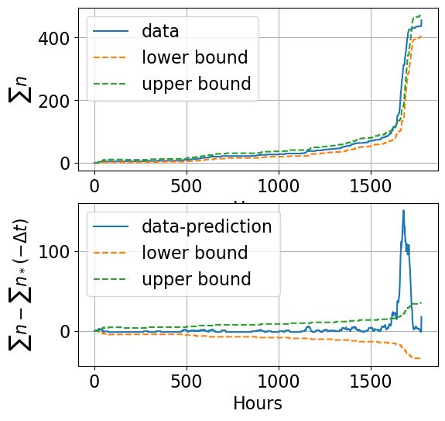
Anomaly detection procedure
We assume the self-discharge rate follows a Poisson distribution.
The self-discharge rate of the normal state is learned during stable operation.
If the self-discharge rate exceeds a certain limit, an alarm signal is sent to the operator.
We can prepare the replacement work in progress of the actual failure.
Anomaly!!

Slide 23
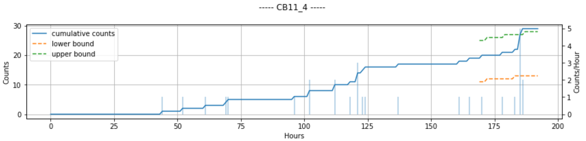
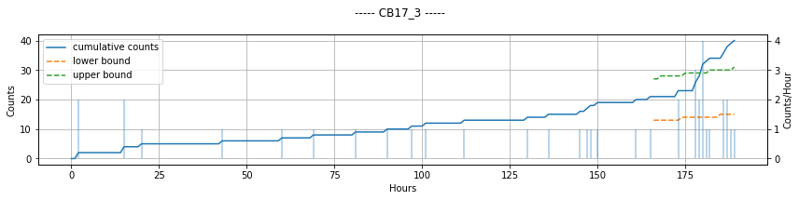
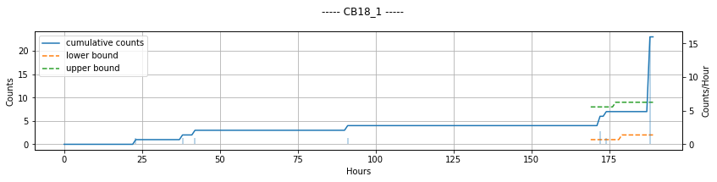
Web application running in SACLA
Examples of thyratrons with anomalies of the self-discharge rate detected by this algorithm

Slide 24
Summary
Various AI/ML tools have been applied to particle accelerators.
The ideas and achievements in the accelerator domain are shared in MaLaPa workshops, etc.
We showed typical successful AI/ML applications to particle accelerators.
  Bayesian optimizers.
  Complex phase-space reconstruction.
  Surrogate models to accelerate simulations.
  Anomaly detection for stable operation.
There are so many results, which can be found in https://malapa.org/.
These new algorithms show better performance than conventional methods.
  Bayesian optimizers showed better than conventional Nelder-Mead simplex, etc.
Some advanced AI/ML algorithms have also been studied very well.
  Reinforcement learning, transformer models for complex time series, etc.

